Slide 1
Responding to Threats and Incidents
Incident Response Day 3

Slide 2
Last Class:
We covered the following topics last class:
Virtual Machines
SIEMs and SOARs
Customizing Wireshark
Walkthrough of attack analysis

Slide 3
Today’s class is a little different:
We will simulate a “Day in the Life” of an SOC analyst
The exercises will be divided into four extended activities in which we will respond, investigate, and analyze various incidents.
The goal is to practice the skills and software we’ve learned throughout the unit in order to better understand an analyst’s position.

Slide 4
Today's exercises involve live malware.
Use your Ubuntu VM to work in a contained environment.
⚠

Slide 5
Part 1: !Alert1!
In this activity, you will investigate a malware attack using a Snort alert and a network pcap.
Instructions sent via Slack
30 minutes
30 minutes
⚠
Today’s exercises involve live malware.
Use your Ubuntu VM to work in a contained environment.

Slide 6
Part 1: !Alert 1!
In this exercise, you will work from an alert file and determine if the alert is a False Positive or a True Positive
Snort file
pcap file
1. What activity is Snort reporting on? (Provide a few alert headlines.)
2. What is the date and time of this alert?
3. What is the external IP address that Snort is flagging for malicious activity?
4. What is the internal IP address that Snort is flagging for malicious activity?
5. What is the source port of the activity?
6. What is the destination port of the activity?
1. What is the MAC Address of the internal computer involved?
2. What is the host name of the internal machine?
3. Can you confirm the date and time this issue occurred?
4. How can you confirm if the Snort alert is accurate?
5. Can you safely verify whether or not malware was downloaded?
6. Would you categorize this alert as a False Positive or a True Positive?
7. If this issue needs to be mitigated, what steps should be taken with the infected machine?
8. What steps should be taken in regards to network security?
9. Would you categorize this issue as a Web, Email or Network attack?

Slide 7
Alert 1

Slide 8
Alert 1 Review: Snort File
What is Snort reporting on? (Provide a few alert headlines.)
Answer on next slide →

Slide 9
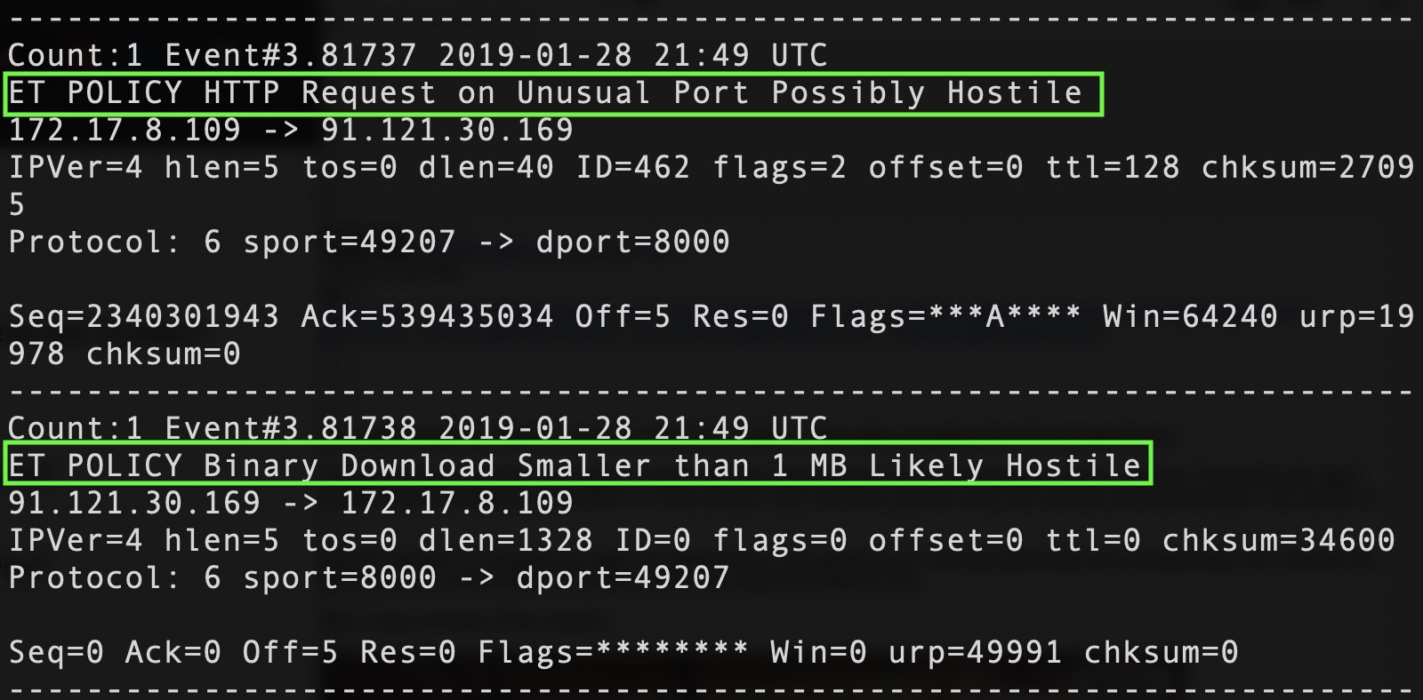
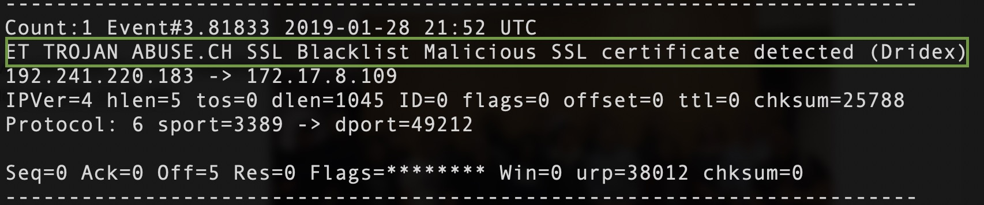
Alert 1 Review: Snort File
What is Snort reporting on? (Provide a few alert headlines.)
“ET POLICY HTTP Request on Unusual Port Possibly Hostile.”
“ET POLICY Binary Download Smaller than 1MB Likely Hostile.”
This is likely where malware was downloaded.
“ET TROJAN ABUSE.CH SSL Blacklist Malicious SSL Certificate detected (Dridex)”
This is the malware running

Slide 10
Alert 1 Review: Snort File
What is the date and time of this alert?
What is the external IP address that Snort is flagging for the ET Policy HTTP?
What is the internal IP address that snort is flagging for the ET Policy HTTP?
What is the source port and destination port of the activity?

Slide 11
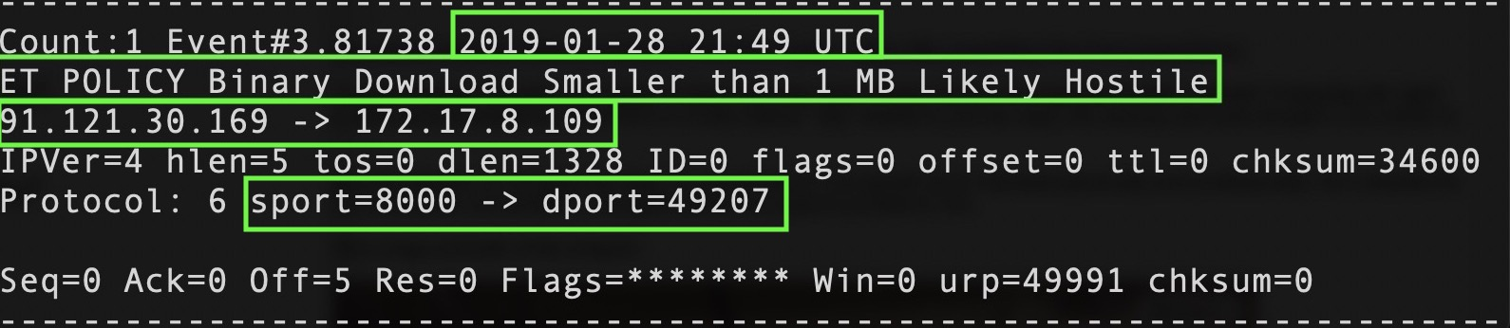
Alert 1 Review: Snort File
What is the date and time of this alert?
2019-01-28 21:49 UTC
What is the external IP address that Snort is flagging for the ET Policy HTTP?
What is the internal IP address that snort is flagging for the ET Policy HTTP?
What is the source port and destination port of the activity?

Slide 12
Alert 1 Review: Snort File
What is the date and time of this alert?
2019-01-28 21:49 UTC
What is the external IP address that Snort is flagging for the ET Policy HTTP?
?
Using the second alert where the malware was likely downloaded, we see 91.121.30.169
What is the internal IP address that snort is flagging for the ET Policy HTTP?
What is the source port and destination port of the activity?

Slide 13
Alert 1 Review: Snort File
What is the date and time of this alert?
2019-01-28 21:49 UTC
What is the external IP address that Snort is flagging for the ET Policy HTTP?
?
Using the second alert where the malware was likely downloaded, we see 91.121.30.169
What is the internal IP address that snort is flagging for the ET Policy HTTP?
?
Using the same alert, we see 172.17.8.109
What is the source port and destination port of the activity?

Slide 14
Alert 1 Review: Snort File
What is the date and time of this alert?
2019-01-28 21:49 UTC
What is the external IP address that Snort is flagging for the ET Policy HTTP?
?
Using the second alert where the malware was likely downloaded, we see 91.121.30.169
What is the internal IP address that snort is flagging for the ET Policy HTTP?
?
Using the same alert, we see 172.17.8.109
What is the source port and destination port of the activity?
Source port = 8000, destination port = 49207

Slide 15
Alert 1 Review: pcap File
What is the MAC Address of the internal computer involved?

Slide 16
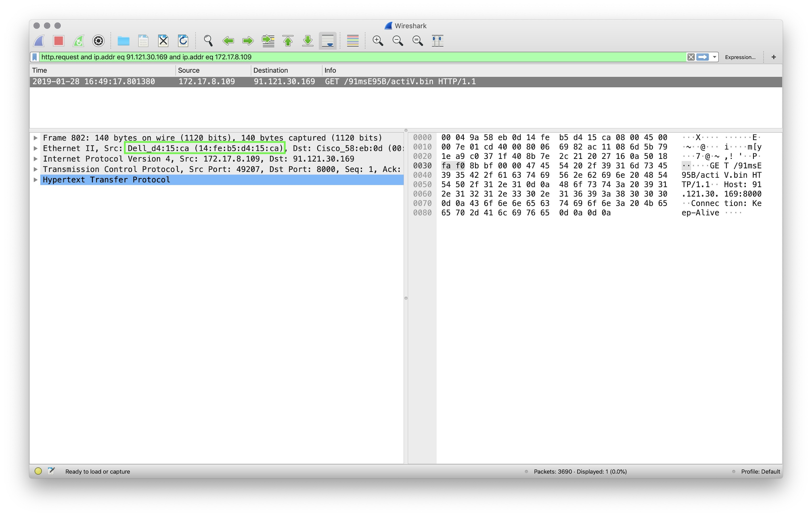
Alert 1 Review: pcap File
What is the MAC Address of the internal computer involved?
Dell (14:fe:b5:d4:15:ca)

Slide 17
Alert 1 Review: pcap File
What is the host name of the internal machine?

Slide 18
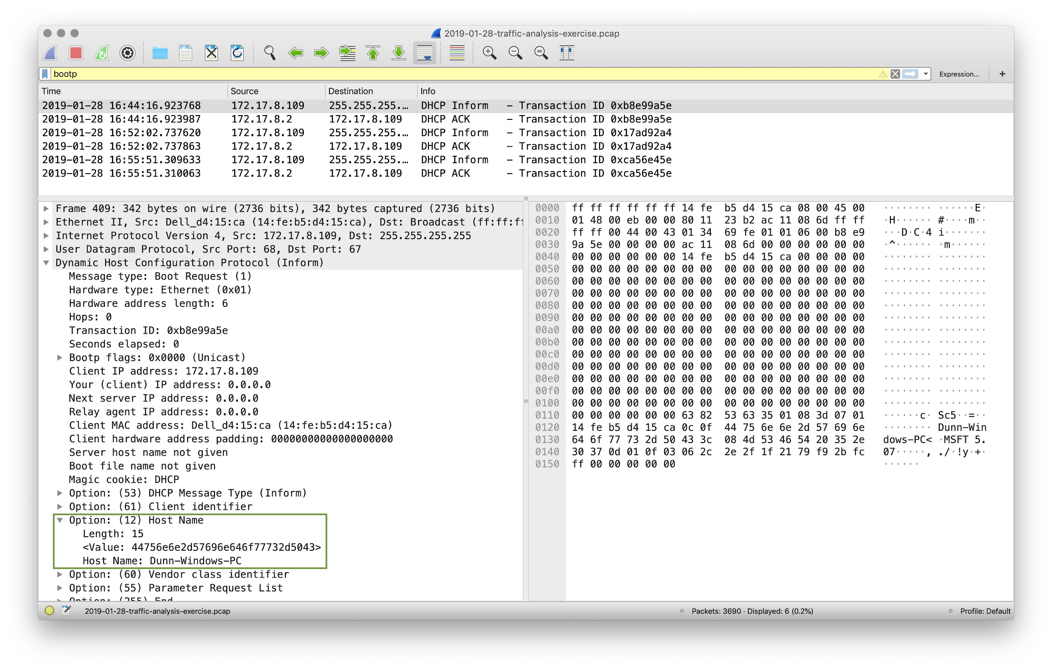
Alert 1 Review: pcap File
What is the host name of the internal machine?
Filter for DHCP traffic using bootp. bootp stands for bootstrap protocol. It is the protocol that DHCP traffic used.
Note: You can also filter for DHCP
using udp.port eq 68 to filter for
traffic on port 68.
Host name is Dunn-Windows-PC.

Slide 19
Alert 1 Review: pcap File
Filter the pcap file to show the conversation between the two machines that were identified in the Snort Alert.
Can you confirm the date and time this issue occurred?

Slide 20
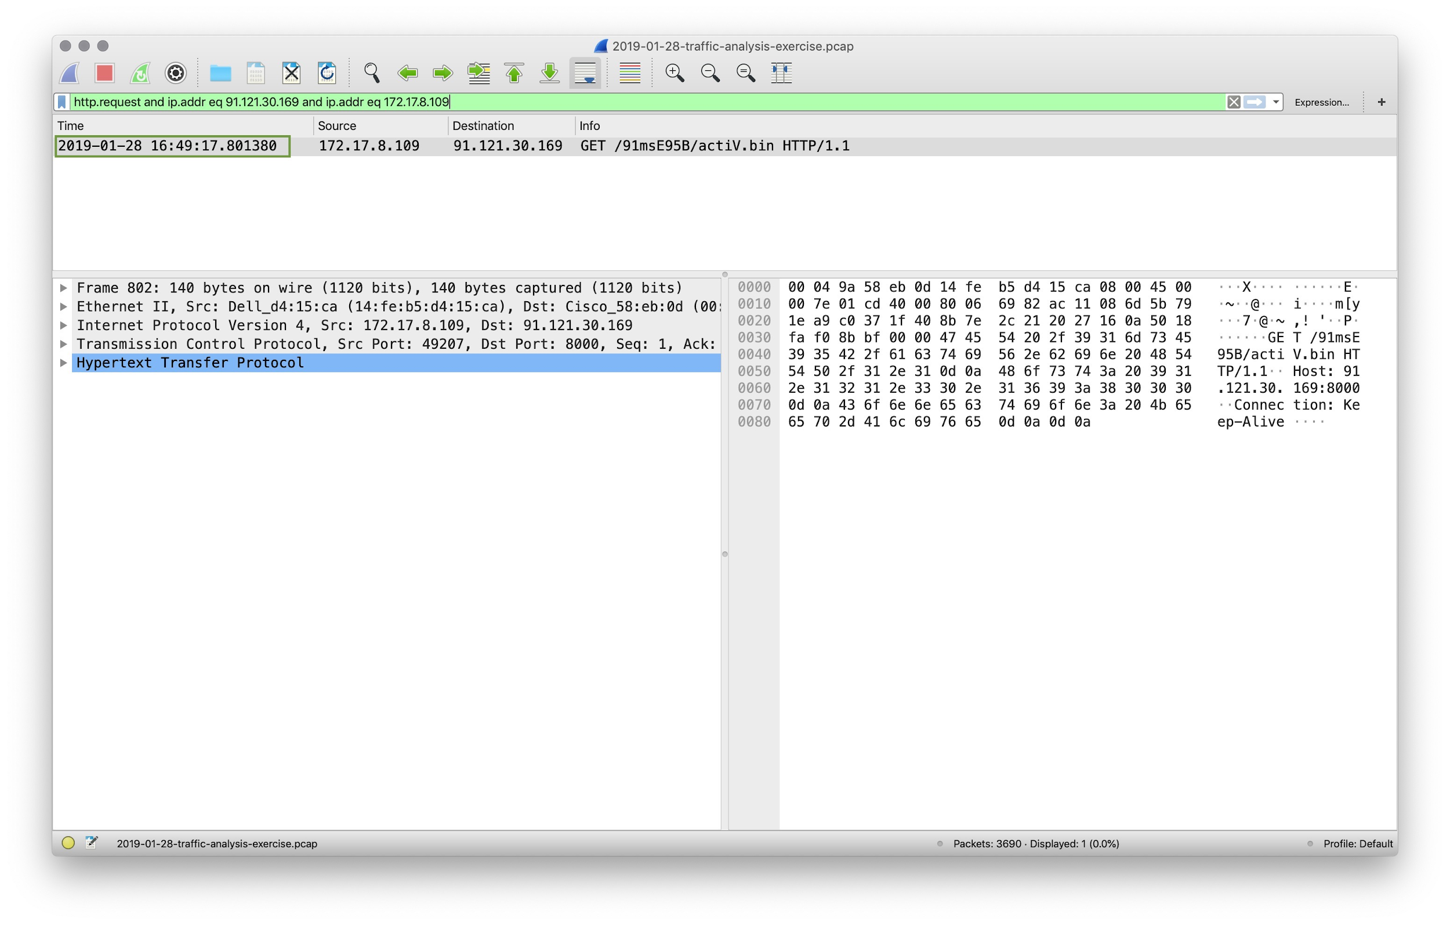
Alert 1 Review: pcap File
Filter the pcap file to show the conversation between the two machines that were identified in the Snort Alert.
http.request and ip.addr eq 91.121.30.169 and ip.addr eq 172.12.8.109
Can you confirm the date and time this issue occurred?

Slide 21
Alert 1 Review: pcap File
Filter the pcap file to show the conversation between the two machines that were identified in the Snort Alert.
http.request and ip.addr eq 91.121.30.169 and ip.addr eq 172.12.8.109
Can you confirm the date and time this issue occurred?
Filtering on HTTP and IP addresses, we have a packet at
2019-01-28 16:49:17

Slide 22
Alert 1 Review: pcap File
How can you confirm if the Snort alert is accurate?

Slide 23
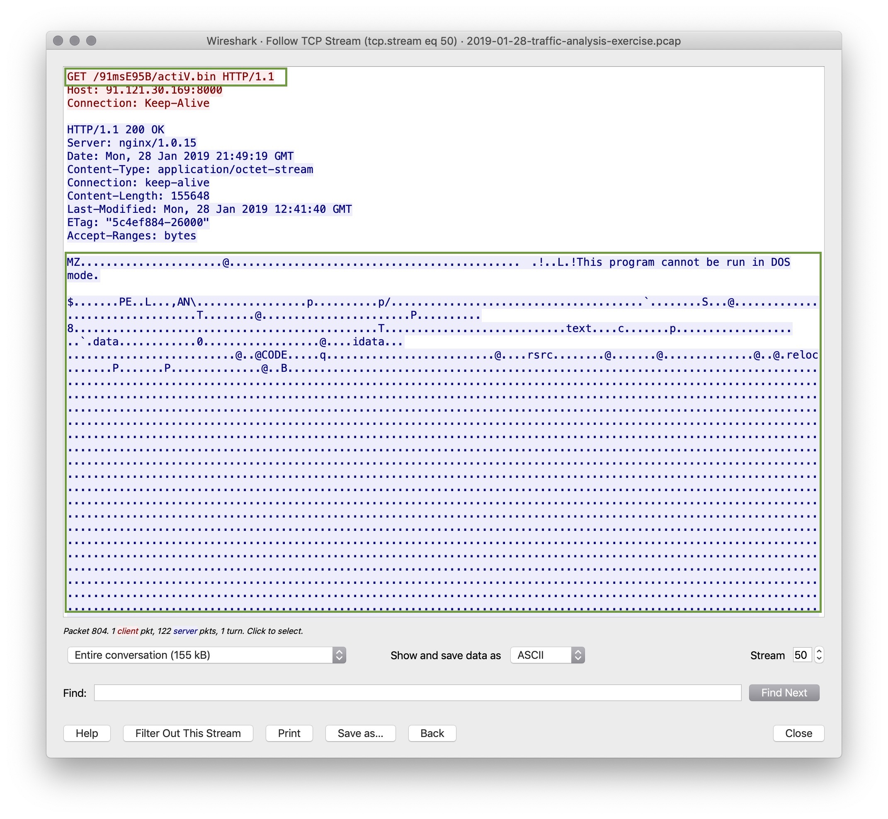
Alert 1 Review: pcap File
How can you confirm if the Snort alert is accurate?
Follow the TCP stream and you will see the binary download starting with ‘MZ’ and “!This program cannot be run in DOS mode.”
The GET request ends in /actiV.bin

Slide 24
Alert 1 Review: pcap File
Can you safely view whether or not malware was downloaded?

Slide 25
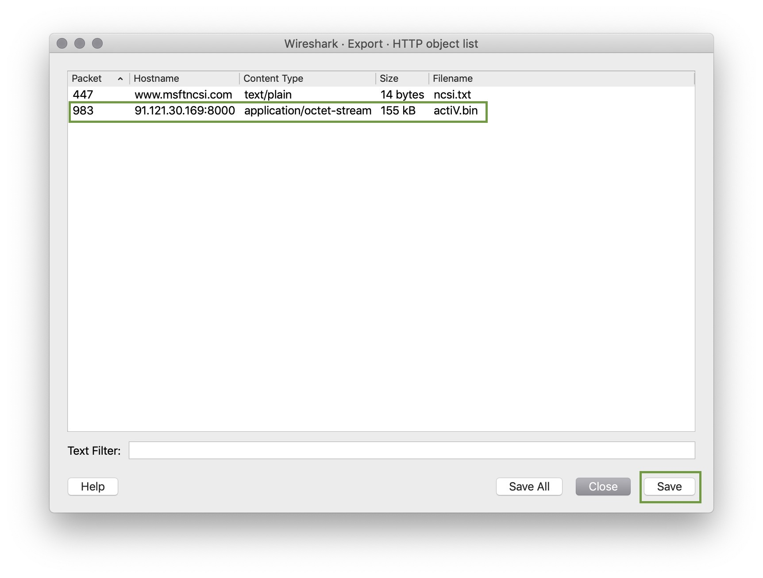
Alert 1 Review: pcap File
Can you safely view whether or not malware was downloaded?
Using File > Export Objects > HTTP find the actiV.bin file and save it.
Run md5sum actiV.bin to get a hash of the file.
Search the hash at Virus Total.

Slide 26
Alert 1 Review: pcap File
Would you categorize this alert as a False Positive or a True Positive?
If this issue needs to be mitigated, what steps should be taken when the infected machine?
What steps should be taken in regards to network security?
Would you categorize this issue as a Web, Email or Network attack?

Slide 27
Alert 1 Review: pcap File
Would you categorize this alert as a False Positive or a True Positive?
We have verified that malware was download, so this is a True Positive.
If this issue needs to be mitigated, what steps should be taken when the infected machine?
What steps should be taken in regards to network security?
Would you categorize this issue as a Web, Email or Network attack?

Slide 28
Alert 1 Review: pcap File
Would you categorize this alert as a False Positive or a True Positive?
We have verified that malware was download, so this is a True Positive.
If this issue needs to be mitigated, what steps should be taken when the infected machine?
The machine should be restored to a backup prior to this infection.
What steps should be taken in regards to network security?
Would you categorize this issue as a Web, Email or Network attack?

Slide 29
Alert 1 Review: pcap File
Would you categorize this alert as a False Positive or a True Positive?
We have verified that malware was download, so this is a True Positive.
If this issue needs to be mitigated, what steps should be taken when the infected machine?
The machine should be restored to a backup prior to this infection.
What steps should be taken in regards to network security?
Using Wireshark Tools > ACL Rules we can get a rule for the offering IP:
#IPv4 source address
iptables --append INPUT --in-interface etho --source 91.121.30.169/32 --jump DROP
Would you categorize this issue as a Web, Email or Network attack?

Slide 30
Alert 1 Review: pcap File
Would you categorize this alert as a False Positive or a True Positive?
We have verified that malware was download, so this is a True Positive.
If this issue needs to be mitigated, what steps should be taken when the infected machine?
The machine should be restored to a backup prior to this infection.
What steps should be taken in regards to network security?
Using Wireshark Tools > ACL Rules we can get a rule for the offering IP:
#IPv4 source address
iptables --append INPUT --in-interface etho --source 91.121.30.169/32 --jump DROP
Would you categorize this issue as a Web, Email or Network attack?
This attack was carried out by the victim clicking on a malicious web link, so this is a Web Attack.

Slide 31
Part 2: !Alert2!
In this activity, you will work on investigating two alert files, a pcap and three emails to determine if the alerts are a false positive or a true positive.
Instructions sent via Slack
30 minutes
⚠
Today's exercises involve live malware.
Use your Ubuntu VM to work in a contained environment.

Slide 32
Part 2: !Alert 2!
In this activity, you will work on investigating two alert files, a pcap and three emails to determine if the alerts are a false positive or a true positive.
Snort file
pcap file
1. What activity is Snort reporting on? (Provide a few alert headlines.)
2. What is the date and time of this alert?
3. What is the external IP address that Snort is flagging for the ET POLICY Binary alert?
4. What is the internal IP address that Snort is flagging for the ET POLICY Binary alert?
5. What is the source port of the activity?
6. What is the destination port of the activity?
1. What is the MAC Address of the internal computer involved?
2. What is the host name of the internal machine?
3. Can you confirm the date and time this issue occurred?
4. How can you confirm if the Snort Alert is accurate?
5. Can you safely verify whether or not malware was downloaded?
6. Can you determine which email had a malware attachment related to the Snort Alerts?
7. Would you categorize this alert as a False Positive or a True Positive?
8. If this issue needs to be mitigated, what steps should be taken with the infected machine?
9. What steps should be taken in regards to network security?
10. Would you categorize this issue as a Web, Email or Network attack?

Slide 33
Alert 2

Slide 34
Alert 2 Review: Snort File
What is Snort reporting on? (Provide a few alert headlines.)

Slide 35
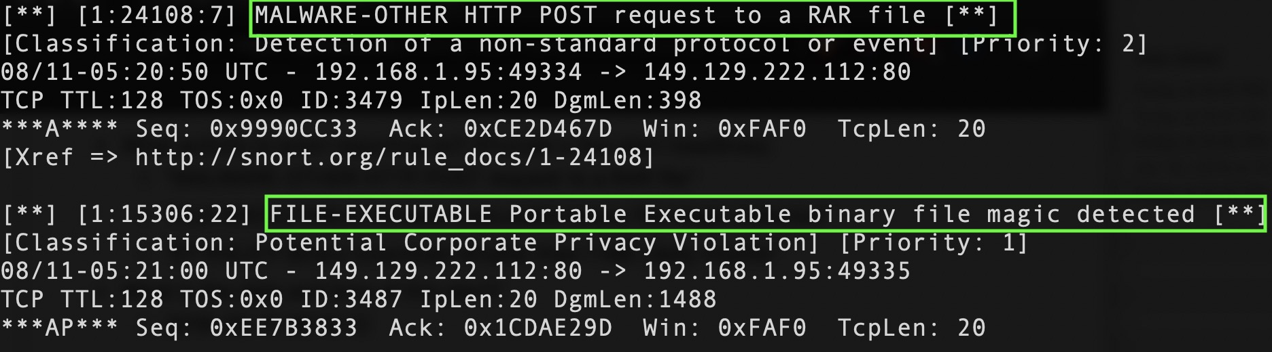
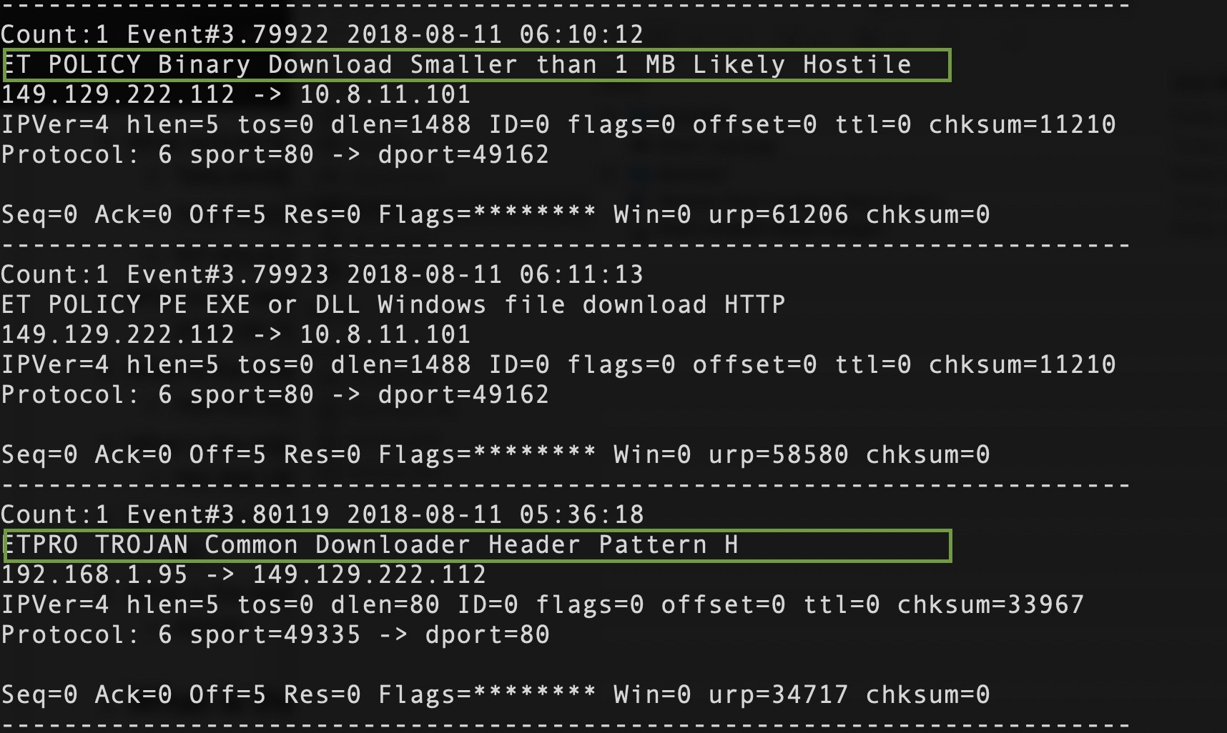
Alert 2 Review: Snort File
What is Snort reporting on? (Provide a few alert headlines.)
“MALWARE -OTHER HTTP POST request to a RAR file”
"FILE-EXECUTABLE Portable Executable binary file magic detected"
"ET POLICY Binary Download Smaller than 1 MB Likely Hostile"
"ETPRO TROJAN Common Downloader Header
Pattern H"

Slide 36
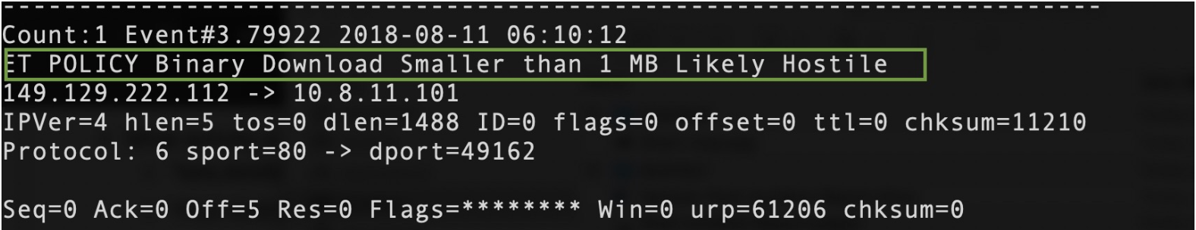
Alert 2 Review: Snort File
What is the date and time of the ET POLICY Binary alert?
What is the external IP address that Snort is flagging for the ET POLICY Binary alert?
What is the internal IP address that snort is flagging for the ET POLICY Binary alert?
What is the source port and destination port of the activity?

Slide 37
Alert 2 Review: Snort File
What is the date and time of the ET POLICY Binary alert?
2018-08-11 06:10:12
What is the external IP address that Snort is flagging for the ET POLICY Binary alert?
What is the internal IP address that snort is flagging for the ET POLICY Binary alert?
What is the source port and destination port of the activity?

Slide 38
Alert 2 Review: Snort File
What is the date and time of the ET POLICY Binary alert?
2018-08-11 06:10:12
What is the external IP address that Snort is flagging for the ET POLICY Binary alert?
149.129.222.112
What is the internal IP address that snort is flagging for the ET POLICY Binary alert?
What is the source port and destination port of the activity?

Slide 39
Alert 2 Review: Snort File
What is the date and time of the ET POLICY Binary alert?
2018-08-11 06:10:12
What is the external IP address that Snort is flagging for the ET POLICY Binary alert?
149.129.222.112
What is the internal IP address that snort is flagging for the ET POLICY Binary alert?
10.8.11.101
What is the source port and destination port of the activity?

Slide 40
Alert 2 Review: Snort File
What is the date and time of the ET POLICY Binary alert?
2018-08-11 06:10:12
What is the external IP address that Snort is flagging for the ET POLICY Binary alert?
149.129.222.112
What is the internal IP address that snort is flagging for the ET POLICY Binary alert?
10.8.11.101
What is the source port and destination port of the activity?
Source port = 80, destination port = 49162

Slide 41
Alert 2 Review
What is the MAC Address of the internal computer involved?
What is the host name of the internal machine

Slide 42
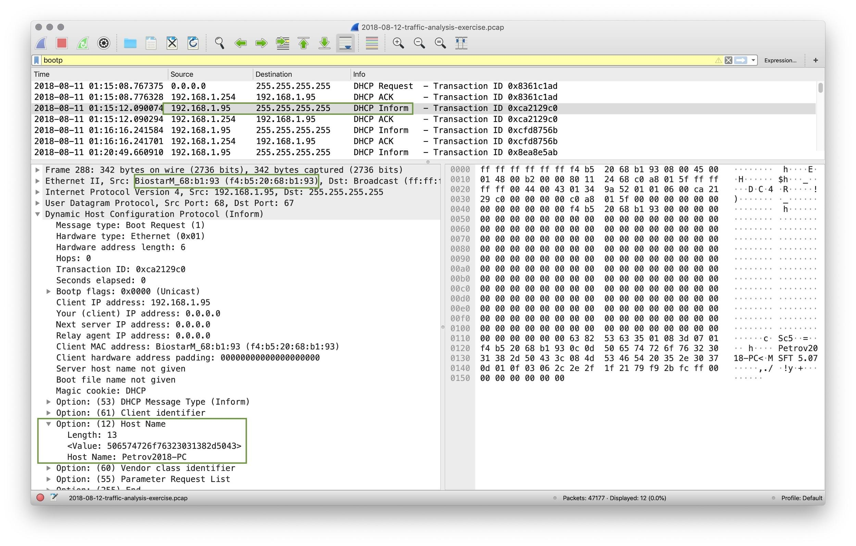
Alert 2 Review
What is the MAC Address of the internal computer involved?
f4:b5:20:68:b1:93
What is the host name of the internal machine

Slide 43
Alert 2 Review
What is the MAC Address of the internal computer involved?
f4:b5:20:68:b1:93
What is the host name of the internal machine
Filter for bootp in Wireshark and inspect Option: Host Name from an Inform packet.
Petrov2018-PC

Slide 44
Alert 2 Review
Can you confirm the date and time this issue occurred?

Slide 45
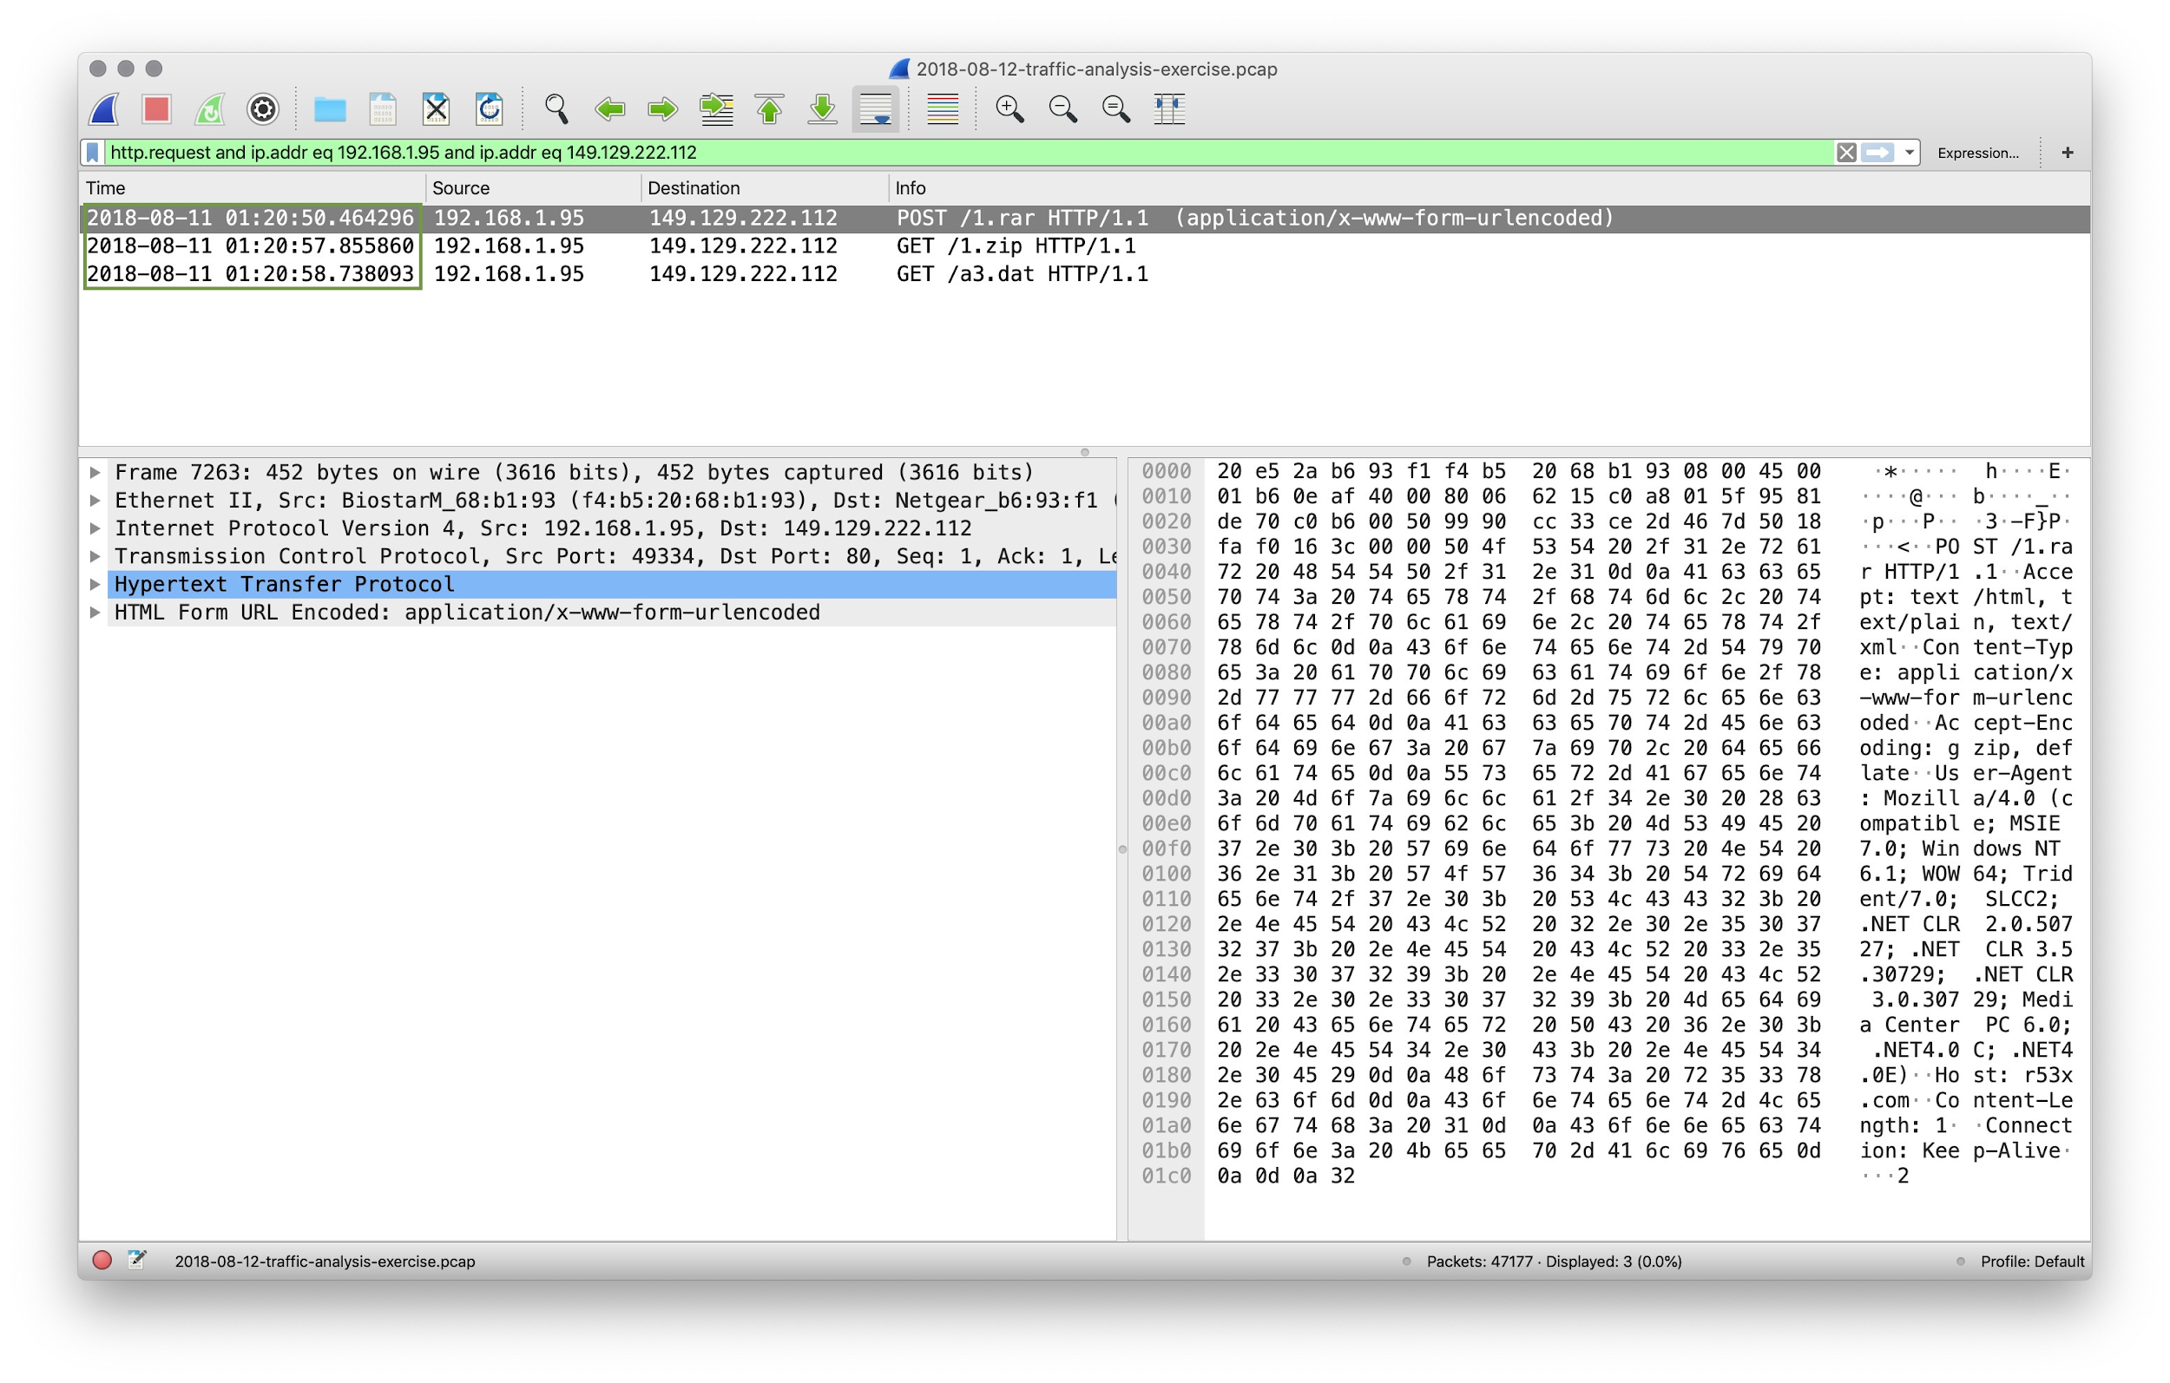
Alert 2 Review
Can you confirm the date and time this issue occurred?
pcap file shows 2018-08-11 1:20 UTC

Slide 46
Alert 2 Review
How can you confirm if the Snort alert is accurate?

Slide 47
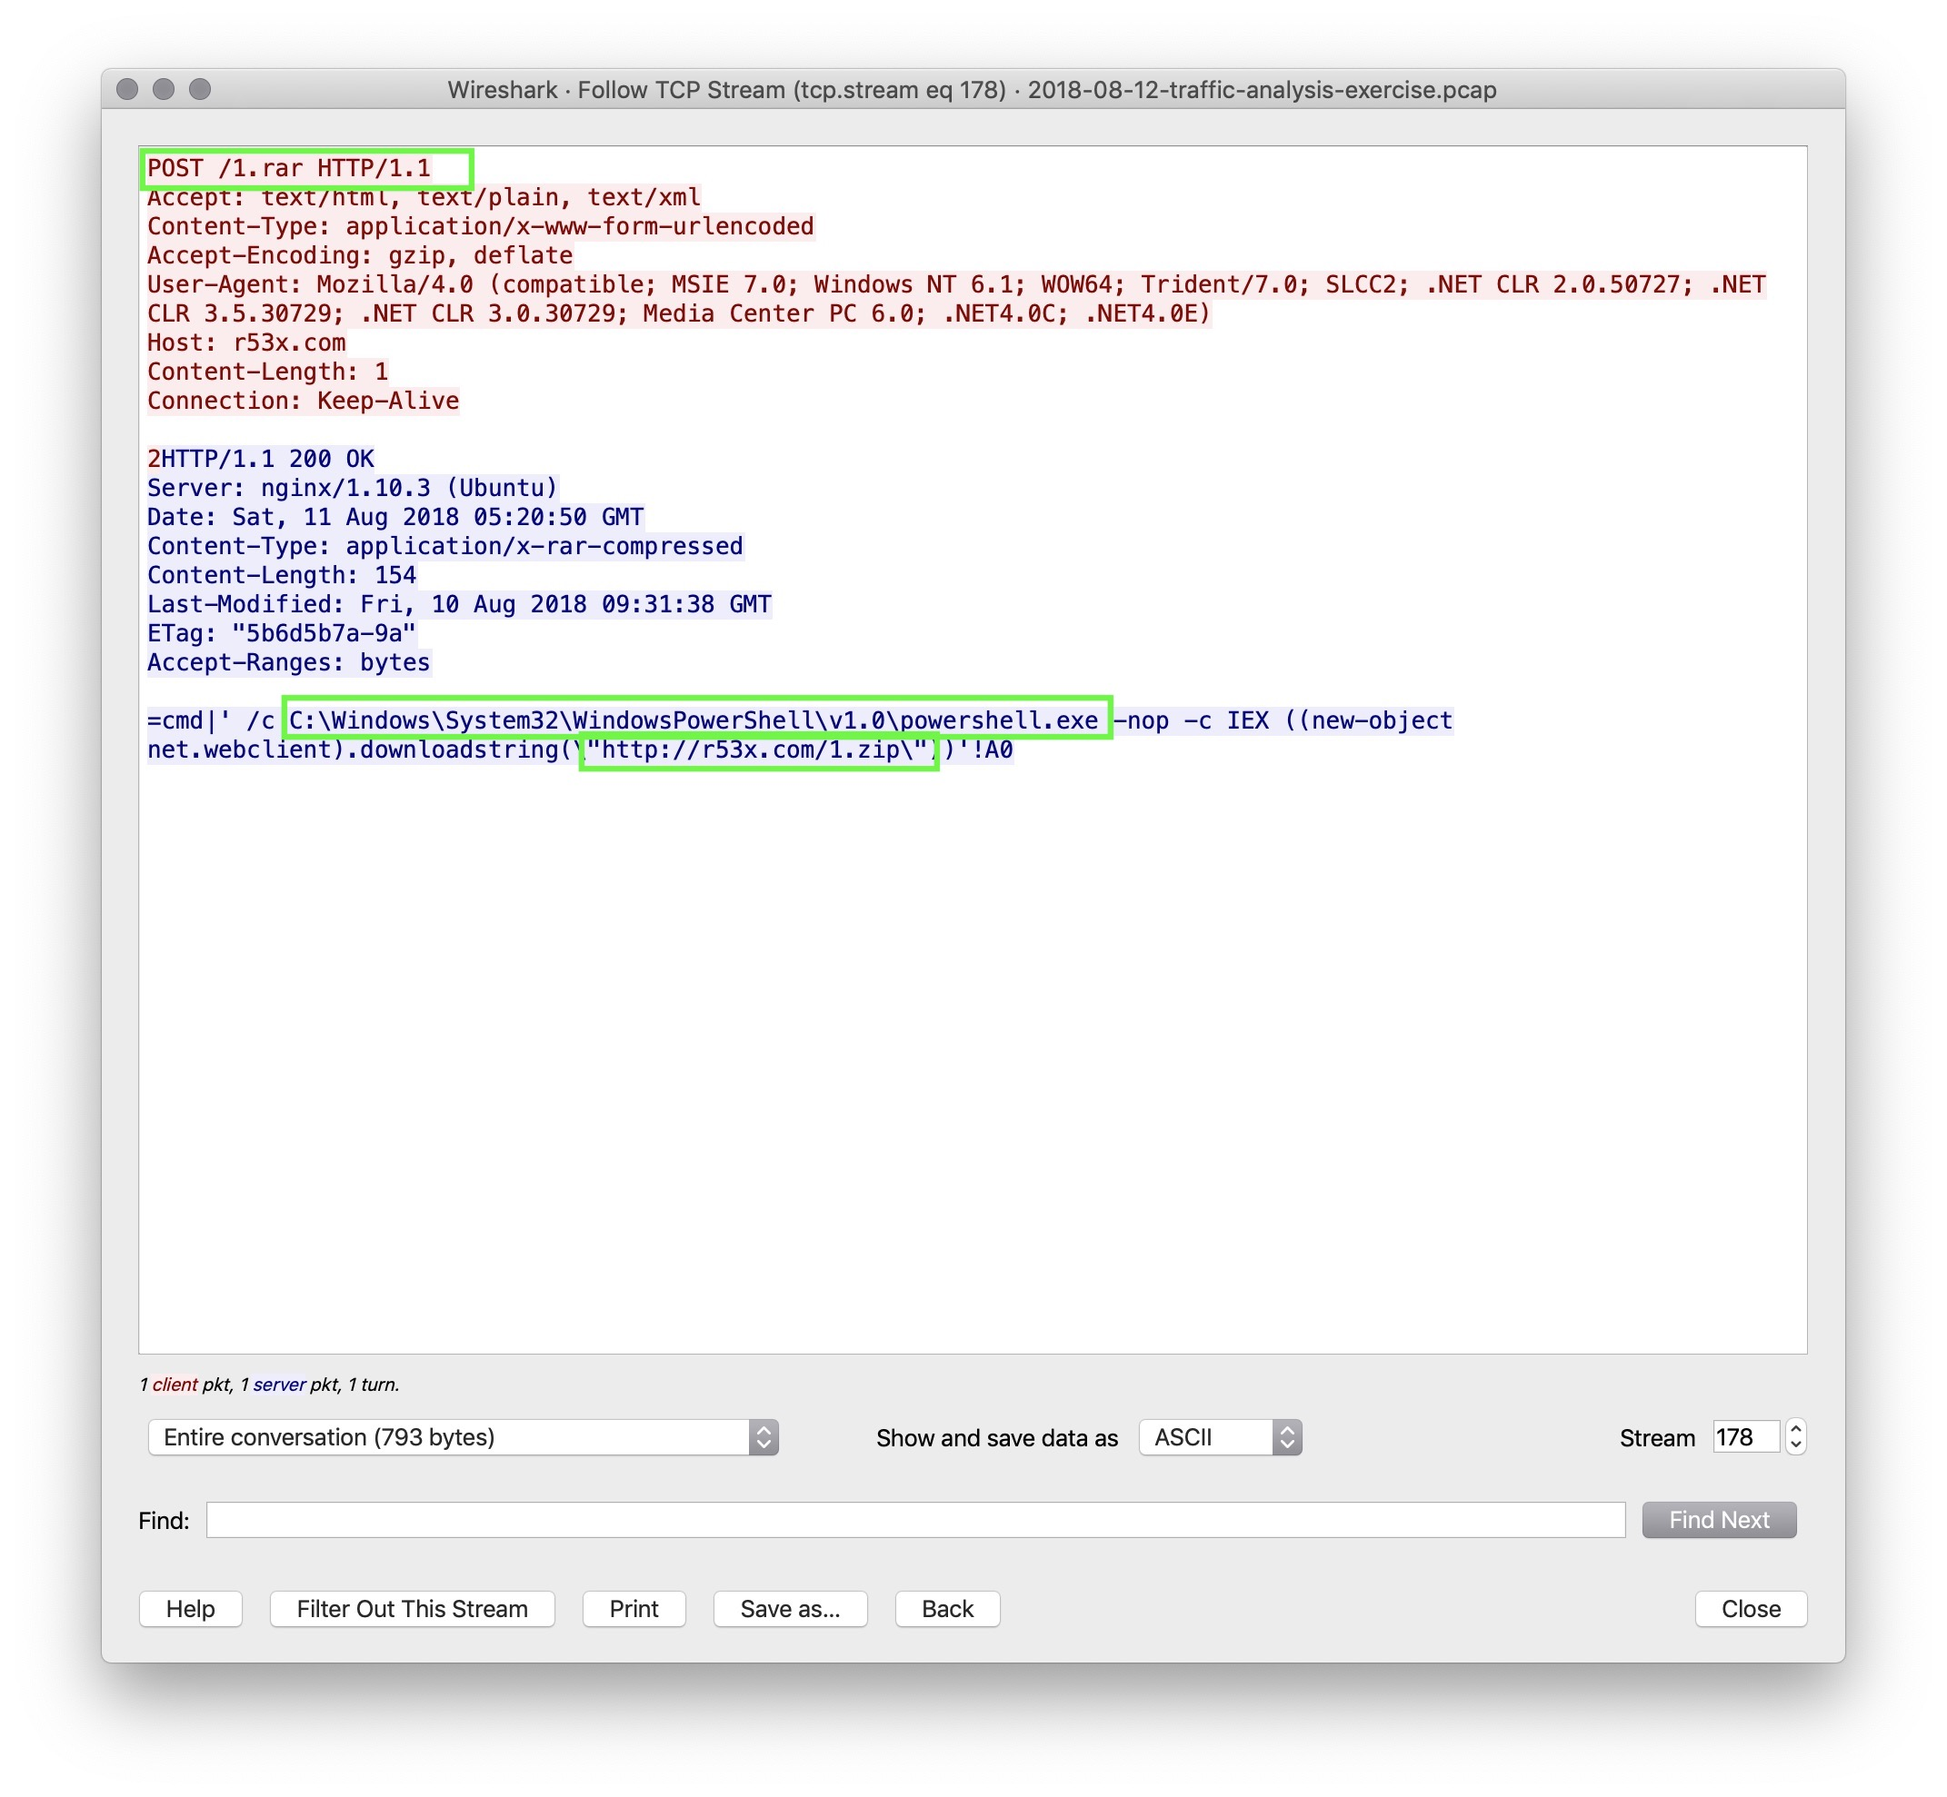
Alert 2 Review
How can you confirm if the Snort alert is accurate?
Following the TCP Stream of the machines in the alert shows a POST request to /1.rar.
The rest of the stream shows a powershell command that downloads an executable r53x.com/1.zip.

Slide 48
Alert 2 Review
Can you safely verify whether or not malware was downloaded?

Slide 49
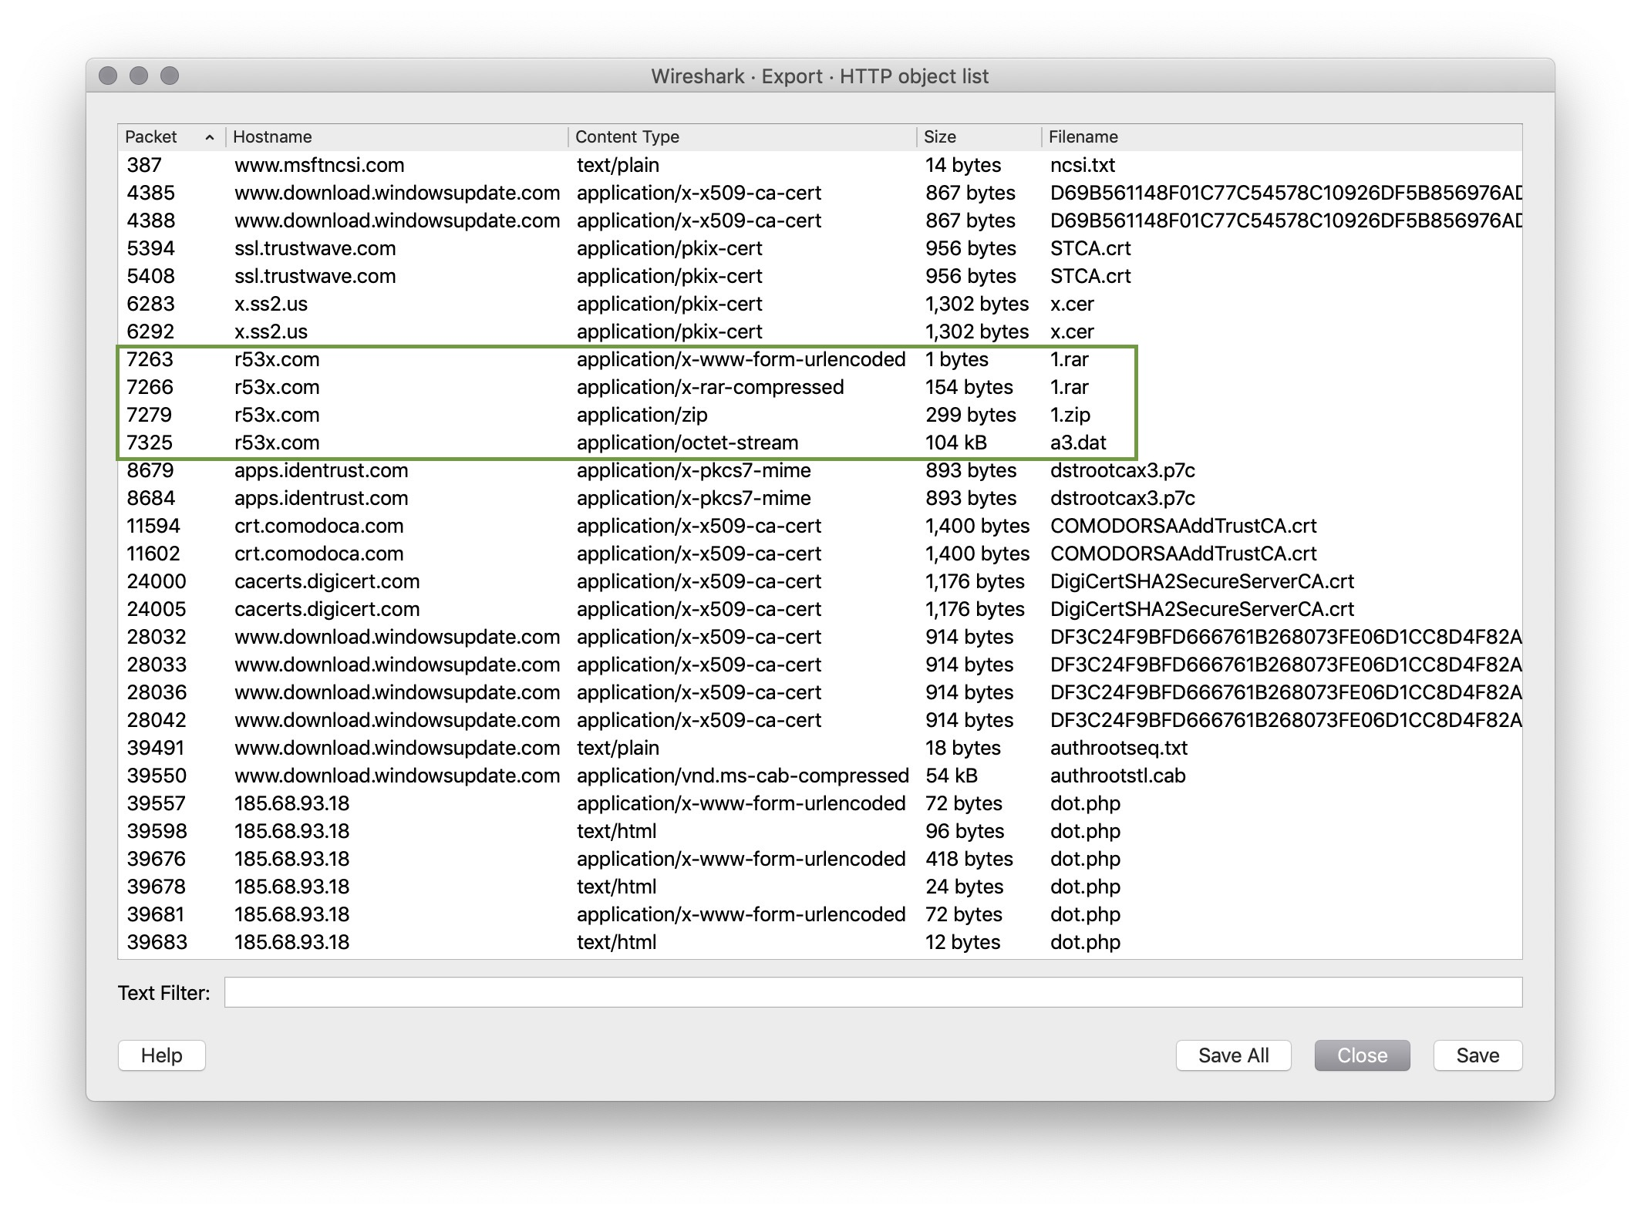
Alert 2 Review
Can you safely verify whether or not malware was downloaded?
Using File > Export Objects > HTTP, you can export 1.zip and 1.rar files.
Verify this malware using md5sum and Virus Total.

Slide 50
Alert 2 Review
Can you determine which email had a malware attachment related to the Snort Alerts?

Slide 51
Alert 2 Review
Can you determine which email had a malware attachment related to the Snort Alerts?
Locate the .eml activity files that you downloaded at the start of the exercise.
Open each email by right-clicking and choosing ‘Open with other application’ > Thunderbird Mail.
Save all 3 attachments from each email in the activity directory.
Use the file command to determine the file type of each file.
Open the files (PIC35793.iqy) is a text file.
Using the less command, we can see a link inside: r53x.com/1.rar
The first email appears to be the culprit.

Slide 52
Alert 2 Review
Would you categorize this alert as a False Positive or a True Positive?
If this issue needs to be mitigated, what steps should be taken when the infected machine?
What steps should be taken in regards to network security?
Would you categorize this issue as a Web, Email or Network attack?

Slide 53
Alert 2 Review
Would you categorize this alert as a False Positive or a True Positive?
We have confirmed a malware infection, so this is a True Positive.
If this issue needs to be mitigated, what steps should be taken when the infected machine?
What steps should be taken in regards to network security?
Would you categorize this issue as a Web, Email or Network attack?

Slide 54
Alert 2 Review
Would you categorize this alert as a False Positive or a True Positive?
We have confirmed a malware infection, so this is a True Positive.
If this issue needs to be mitigated, what steps should be taken when the infected machine?
The machine should be restored to a backup prior to this infection.
What steps should be taken in regards to network security?
Would you categorize this issue as a Web, Email or Network attack?

Slide 55
Alert 2 Review
Would you categorize this alert as a False Positive or a True Positive?
We have confirmed a malware infection, so this is a True Positive.
If this issue needs to be mitigated, what steps should be taken when the infected machine?
The machine should be restored to a backup prior to this infection.
What steps should be taken in regards to network security?
We can block the IP address using:
iptables --append INPUT --in-interface eth0 --source 149.129.222.112/32 --jump Drop
Would you categorize this issue as a Web, Email or Network attack?

Slide 56
Alert 2 Review
Would you categorize this alert as a False Positive or a True Positive?
We have confirmed a malware infection, so this is a True Positive.
If this issue needs to be mitigated, what steps should be taken when the infected machine?
The machine should be restored to a backup prior to this infection.
What steps should be taken in regards to network security?
We can block the IP address using:
iptables --append INPUT --in-interface eth0 --source 149.129.222.112/32 --jump Drop
Would you categorize this issue as a Web, Email or Network attack?
This issue started with an email attachment, so it would be classified as an Email Attack.

Slide 58
Part 3: Alert 3!
In this activity, you will practice responding to an alert to determine if it is a false positive or a true positive alert.
Instructions sent via Slack
30 minutes
30 minutes
⚠
Today's exercises involve live malware.
Use your Ubuntu VM to work in a contained environment.

Slide 59
Part 3: !Alert 3!
In this activity, you will work on investigating two alert files, a pcap and three emails to determine if the alerts are a false positive or a true positive.
Questions:
1. What activity is Snort reporting on?
2. What is the date and time of this alert?
3. What is the external IP address that Snort is flagging for the ET TROJAN VMProtect alert?
4. What is the internal IP address that Snort is flagging for the ET TROJAN VMProtect alert?
5. What is the source port of the activity?
6. What is the destination port of the activity?
7. What are the MAC Addresses of the computers involved?
8. What is the host name of the internal machine?
9. Can you confirm the date and time this issue occurred?
10. How can you confirm if the Snort alert is accurate?
11. Can you safely verify whether or not malware was downloaded?
12. Would you categorize this alert as a False Positive or a True Positive?
14. If this issue needs to be mitigated, what steps should be taken with the infected machine?
14. What steps should be taken in regards to network security?
15. Would you categorize this issue as a Web, Email or Network attack?

Slide 60
Alert 3

Slide 61
Alert 3 Review
What is Snort reporting on? (Provide a few alert headlines.)

Slide 62
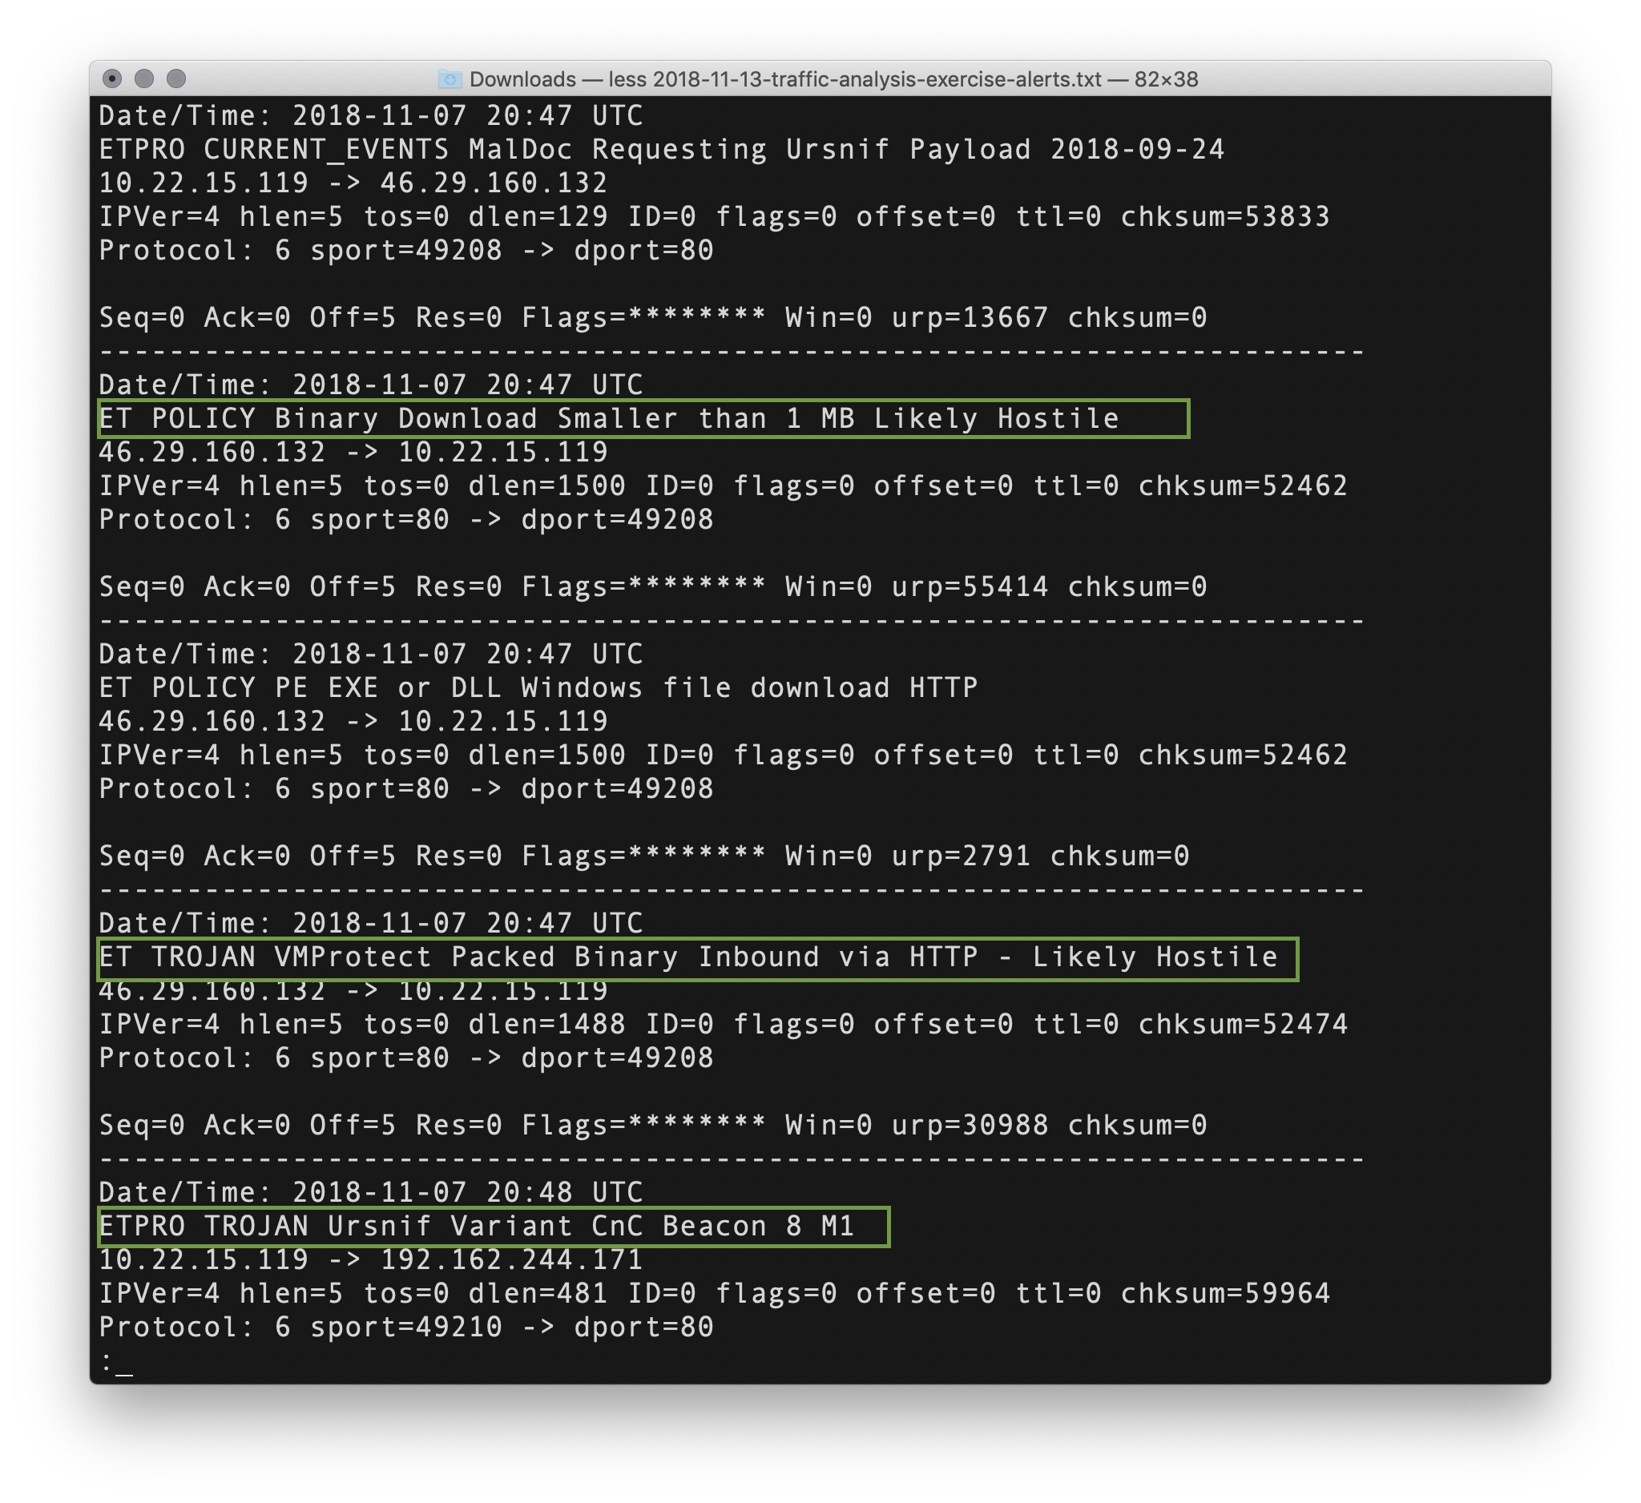
Alert 3 Review
What is Snort reporting on? (Provide a few alert headlines.)
“ET Policy Binary Download Smaller than 1 MB Likely Hostile”
“ET TROJAN VMProtect Packed Binary Inbound Via HTTP - Likely Hostile”
“ETPRO TROJAN Ursnif Variant CnC Beacon 8 M1”

Slide 63
Alert 3 Review
What is the date and time of this alert?
What is the external IP address that Snort is flagging for the ET POLICY Binary alert?
What is the internal IP address that snort is flagging for the ET POLICY Binary alert?
What is the source port and destination port of the activity?

Slide 64
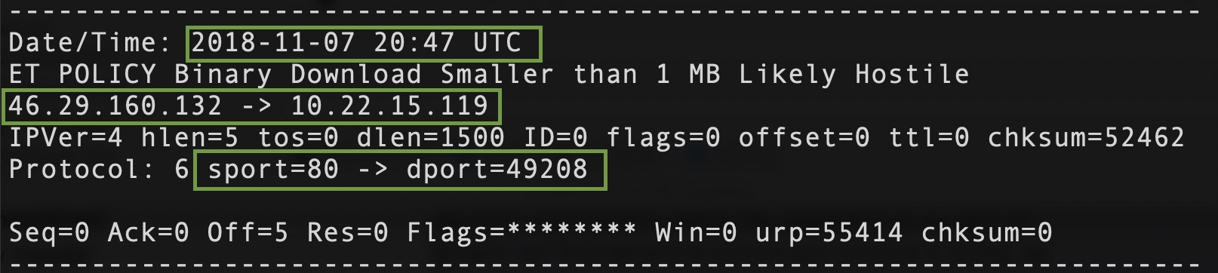
Alert 3 Review
What is the date and time of this alert?
2018-11-07 20:47 UTC
What is the external IP address that Snort is flagging for the ET TROJAN VMProtect alert?
What is the internal IP address that snort is flagging for the ET TROJAN VMProtect alert?
What is the source port and destination port of the ET TROJAN VMProtect alert?

Slide 65
Alert 3 Review
What is the date and time of this alert?
2018-11-07 20:47 UTC
What is the external IP address that Snort is flagging for the ET TROJAN VMProtect alert?
46.29.160.132
What is the internal IP address that snort is flagging for the ET TROJAN VMProtect alert?
What is the source port and destination port of the ET TROJAN VMProtect alert?

Slide 66
Alert 3 Review
What is the date and time of this alert?
2018-11-07 20:47 UTC
What is the external IP address that Snort is flagging for the ET TROJAN VMProtect alert?
46.29.160.132
What is the internal IP address that snort is flagging for the ET TROJAN VMProtect alert?
10.22.15.119
What is the source port and destination port of the ET TROJAN VMProtect alert?

Slide 67
Alert 3 Review
What is the date and time of this alert?
2018-11-07 20:47 UTC
What is the external IP address that Snort is flagging for the ET TROJAN VMProtect alert?
46.29.160.132
What is the internal IP address that snort is flagging for the ET TROJAN VMProtect alert?
10.22.15.119
What is the source port and destination port of the ET TROJAN VMProtect alert?
Source port = 80, destination port = 49208

Slide 68
Alert 3 Review
What is the MAC Address of the internal computer involved?
What is the host name of the internal machine

Slide 69
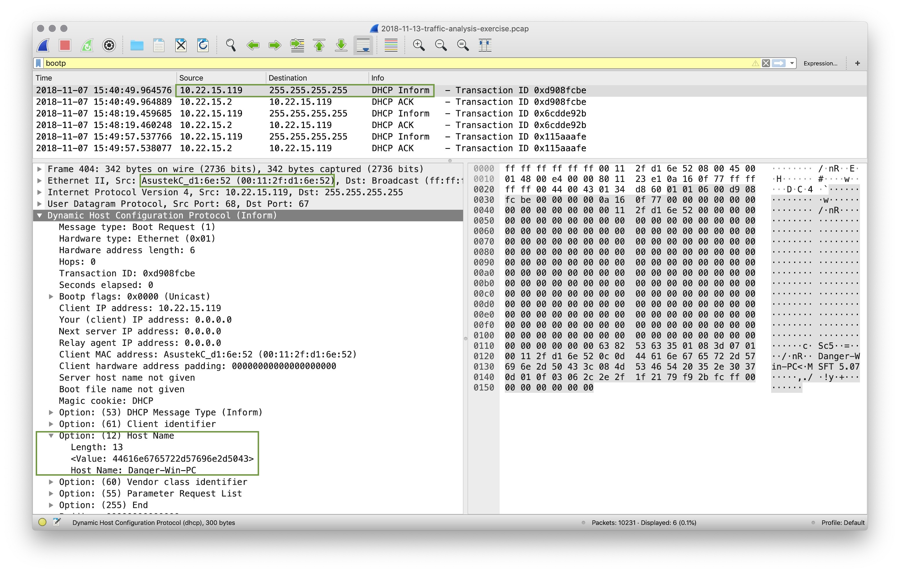
Alert 3 Review
What is the MAC Address of the internal computer involved?
Asustek (possibly a mobile device)
MAC (00:11:2f:d1:6e:52)
What is the host name of the internal machine

Slide 70
Alert 3 Review
What is the MAC Address of the internal computer involved?
Asustek (possibly a mobile device)
MAC (00:11:2f:d1:6e:52)
What is the host name of the internal machine
Wireshark filter on bootp to
get DHCP information.
Host Name is Danger-Win-PC

Slide 71
Alert 3 Review
Filter to show the conversation between the two machines that were identified in the Snort alert.
Can you confirm the date and time this issue occurred?

Slide 72
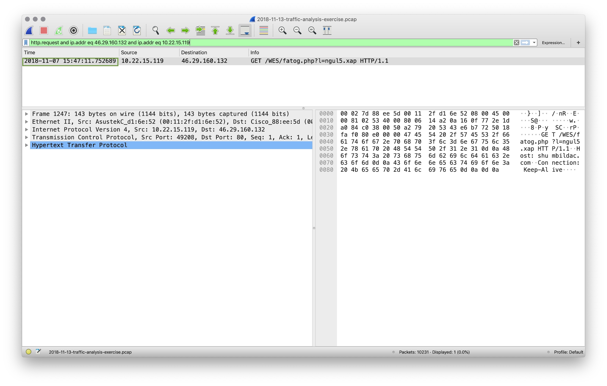
Alert 3 Review
Filter to show the conversation between the two machines that were identified in the Snort alert.
http.request and ip.addr eq 46.29.160.132 and ip.addr eq 10.22.15.119
Can you confirm the date and time this issue occurred?

Slide 73
Alert 3 Review
Filter to show the conversation between the two machines that were identified in the Snort alert.
http.request and ip.addr eq 46.29.160.132 and ip.addr eq 10.22.15.119
Can you confirm the date and time this issue occurred?
2018-11-07 15:47:11

Slide 74
Alert 3 Review
How can you confirm if the Snort alert is accurate?

Slide 75
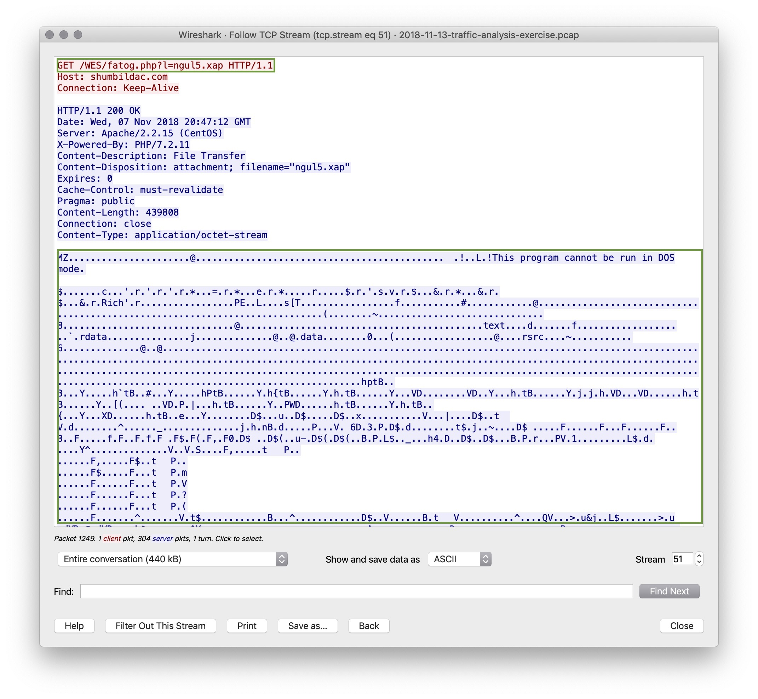
Alert 3 Review
How can you confirm if the Snort alert is accurate?
Following the TCP Stream shows a binary download “This program cannot be run in DOS mode.”
Binary file is fatog.php?l=ngul5.xap

Slide 76
Alert 3 Review
Can you safely verify whether or not malware was downloaded?

Slide 77
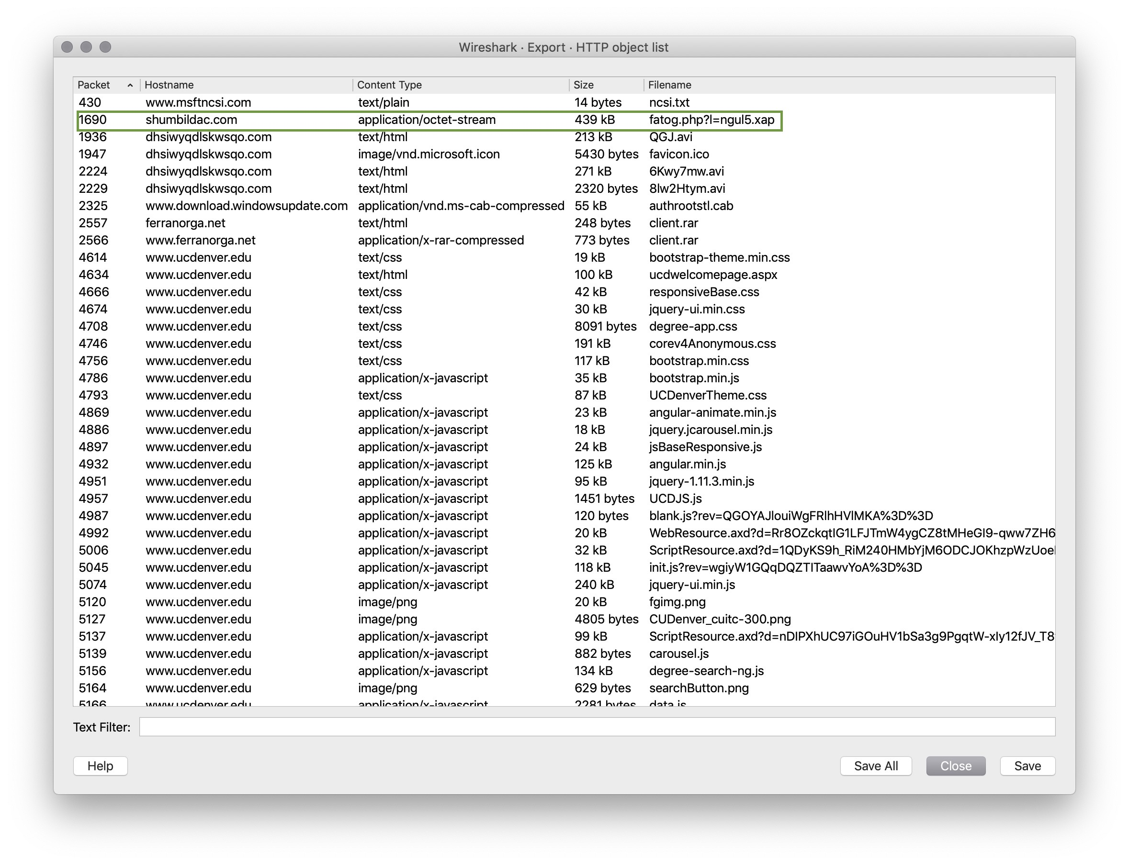
Alert 3 Review
Can you safely verify whether or not malware was downloaded?
Using File > Export Objects > HTTP
Find can fatog.php?l=ngu5.xap in the list and save it.
Make an md5sum hash of the file
and check it with Virus Total.

Slide 78
Alert 3 Review
Would you categorize this alert as a False Positive or a True Positive?
If this issue needs to be mitigated, what steps should be taken when the infected machine?
What steps should be taken in regards to network security?
Would you categorize this issue as a Web, Email or Network attack?

Slide 79
Alert 3 Review
Would you categorize this alert as a False Positive or a True Positive?
We have confirmed that malware was downloaded, so this is a True Positive.
If this issue needs to be mitigated, what steps should be taken when the infected machine?
What steps should be taken in regards to network security?
Would you categorize this issue as a Web, Email or Network attack?

Slide 80
Alert 3 Review
Would you categorize this alert as a False Positive or a True Positive?
We have confirmed that malware was downloaded, so this is a True Positive.
If this issue needs to be mitigated, what steps should be taken when the infected machine?
The machine should be restored to a backup prior to this infection.
What steps should be taken in regards to network security?
Would you categorize this issue as a Web, Email or Network attack?

Slide 81
Alert 3 Review
Would you categorize this alert as a False Positive or a True Positive?
We have confirmed that malware was downloaded, so this is a True Positive.
If this issue needs to be mitigated, what steps should be taken when the infected machine?
The machine should be restored to a backup prior to this infection.
What steps should be taken in regards to network security?
We can block the malicious IP by using Wireshark and navigating to Tools > Firewall ACL Rules.
#IPv4 Destination IP
Iptables --append INPUT --in-interface eth0 --source 46.29.160.132/32 --jump DROP
Would you categorize this issue as a Web, Email or Network attack?

Slide 82
Alert 3 Review
Would you categorize this alert as a False Positive or a True Positive?
We have confirmed that malware was downloaded, so this is a True Positive.
If this issue needs to be mitigated, what steps should be taken when the infected machine?
The machine should be restored to a backup prior to this infection.
What steps should be taken in regards to network security?
We can block the malicious IP by using Wireshark and navigating to Tools > Firewall ACL Rules.
#IPv4 Destination IP
Iptables --append INPUT --in-interface eth0 --source 46.29.160.132/32 --jump DROP
Would you categorize this issue as a Web, Email or Network attack?
This issue was propagated using a malicious Web link, so it is a Web Attack.

Slide 83
Part 4: Alert 4!
In this activity, you will investigate an interesting Snort file.
Instructions sent via Slack
30 minutes
30 minutes
⚠
Today's exercises involve live malware.
Use your Ubuntu VM to work in a contained environment.

Slide 84
Part 4: !Alert 4!
In this final activity, students will investigate an interesting Snort alert...
Questions:
1. What activity is Snort reporting on?
2. Is there a CVE associated with the OS-OTHER Bash alert?
3. What are the IP Addresses flagged in the OS-OTHER Bash alert?
4. Is this attack coming from outside the network?
5. What is the source port of the activity?
6. What is the destination port of the activity?
7. What are the MAC Addresses of the computers involved?
9. Can you confirm the date and time this issue occurred?
10. What was the target of this attack?
11. How can you confirm if the Snort alert is accurate?
12. Can you verify whether or not sensitive data has been obtained by the attacker?
13. Would you categorize this alert as a False Positive or a True Positive?
14. If this issue needs to be mitigated, what steps should be taken with the infected machine?
15. Would you categorize this issue as a Web, Email, Network or Application attack?

Slide 85
Alert 4

Slide 86
Alert 4 Review
What is Snort reporting on? (Provide a few alert headlines.)

Slide 87
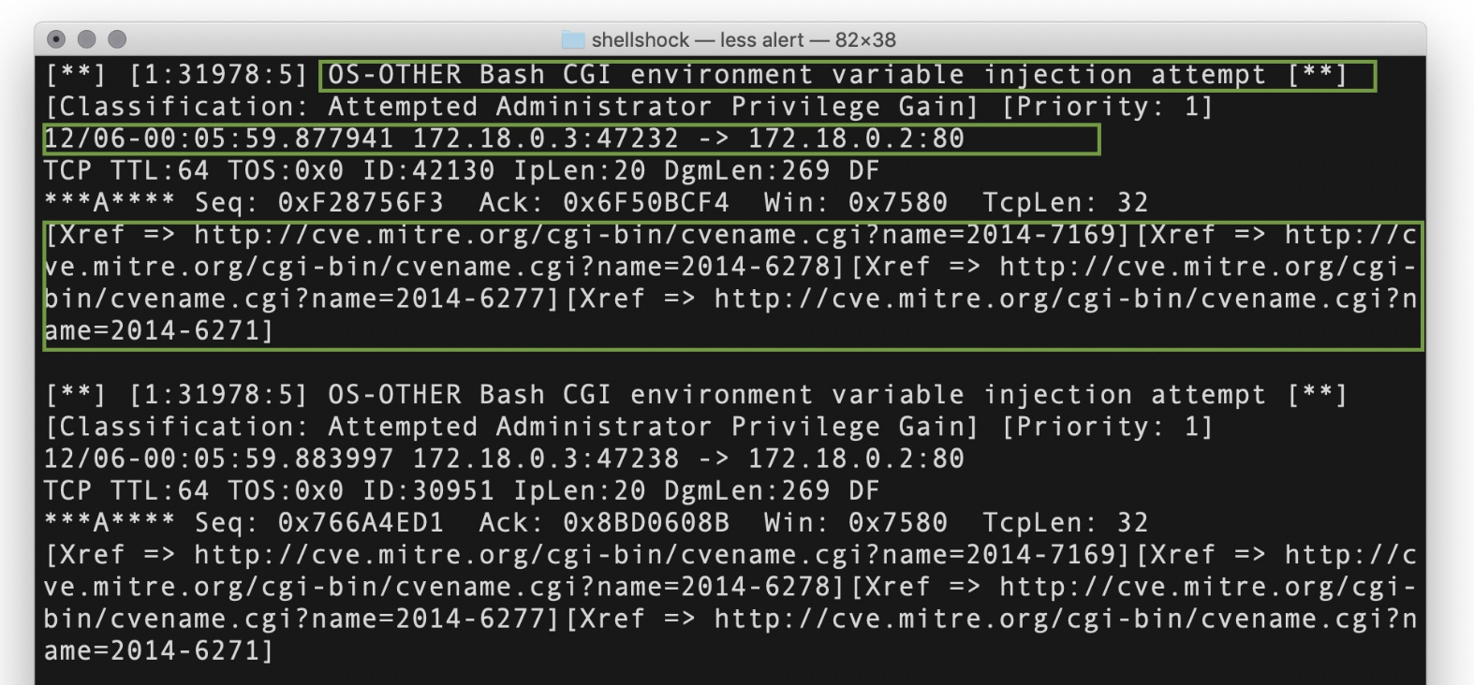
Alert 4 Review
What is Snort reporting on? (Provide a few alert headlines.)
“Attempted Administrator Privilege Gain”
“OS-OTHER Bash CGI environment variable injection attempt”

Slide 88
Alert 4 Review
Is there a CVE associated for the OS-OTHER Bash alert?

Slide 89
Alert 4 Review
Is there a CVE associated for the OS-OTHER Bash alert?
CVE-2014-6271
CVE-2014-7169
CVE-2014-6278
CVE-2014-6277

Slide 90
Alert 4 Review
What are the IP Addresses flagged for the OS-OTHER Bash alert?
Is this attack coming from outside the network?
What is the source port and destination port of the ET TROJAN VMProtect alert?

Slide 91
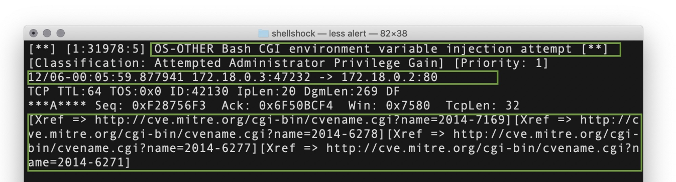
Alert 4 Review
What are the IP Addresses flagged for the OS-OTHER Bash alert?
172.18.0.2 and 172.18.0.3
Is this attack coming from outside the network?
What is the source port and destination port of the ET TROJAN VMProtect alert?

Slide 92
Alert 4 Review
What are the IP Addresses flagged for the OS-OTHER Bash alert?
172.18.0.2 and 172.18.0.3
Is this attack coming from outside the network?
Both IP addresses are internal, so this is one internal machine attacking another.
What is the source port and destination port of the ET TROJAN VMProtect alert?

Slide 93
Alert 4 Review
What are the IP Addresses flagged for the OS-OTHER Bash alert?
172.18.0.2 and 172.18.0.3
Is this attack coming from outside the network?
Both IP addresses are internal, so this is one internal machine attacking another.
What is the source port and destination port of the ET TROJAN VMProtect alert?
Source port = 47232, destination port = 80

Slide 94
Alert 4 Review
What is the MAC Address of the computers involved?
Can you confirm the date and time this issue occurred?

Slide 95
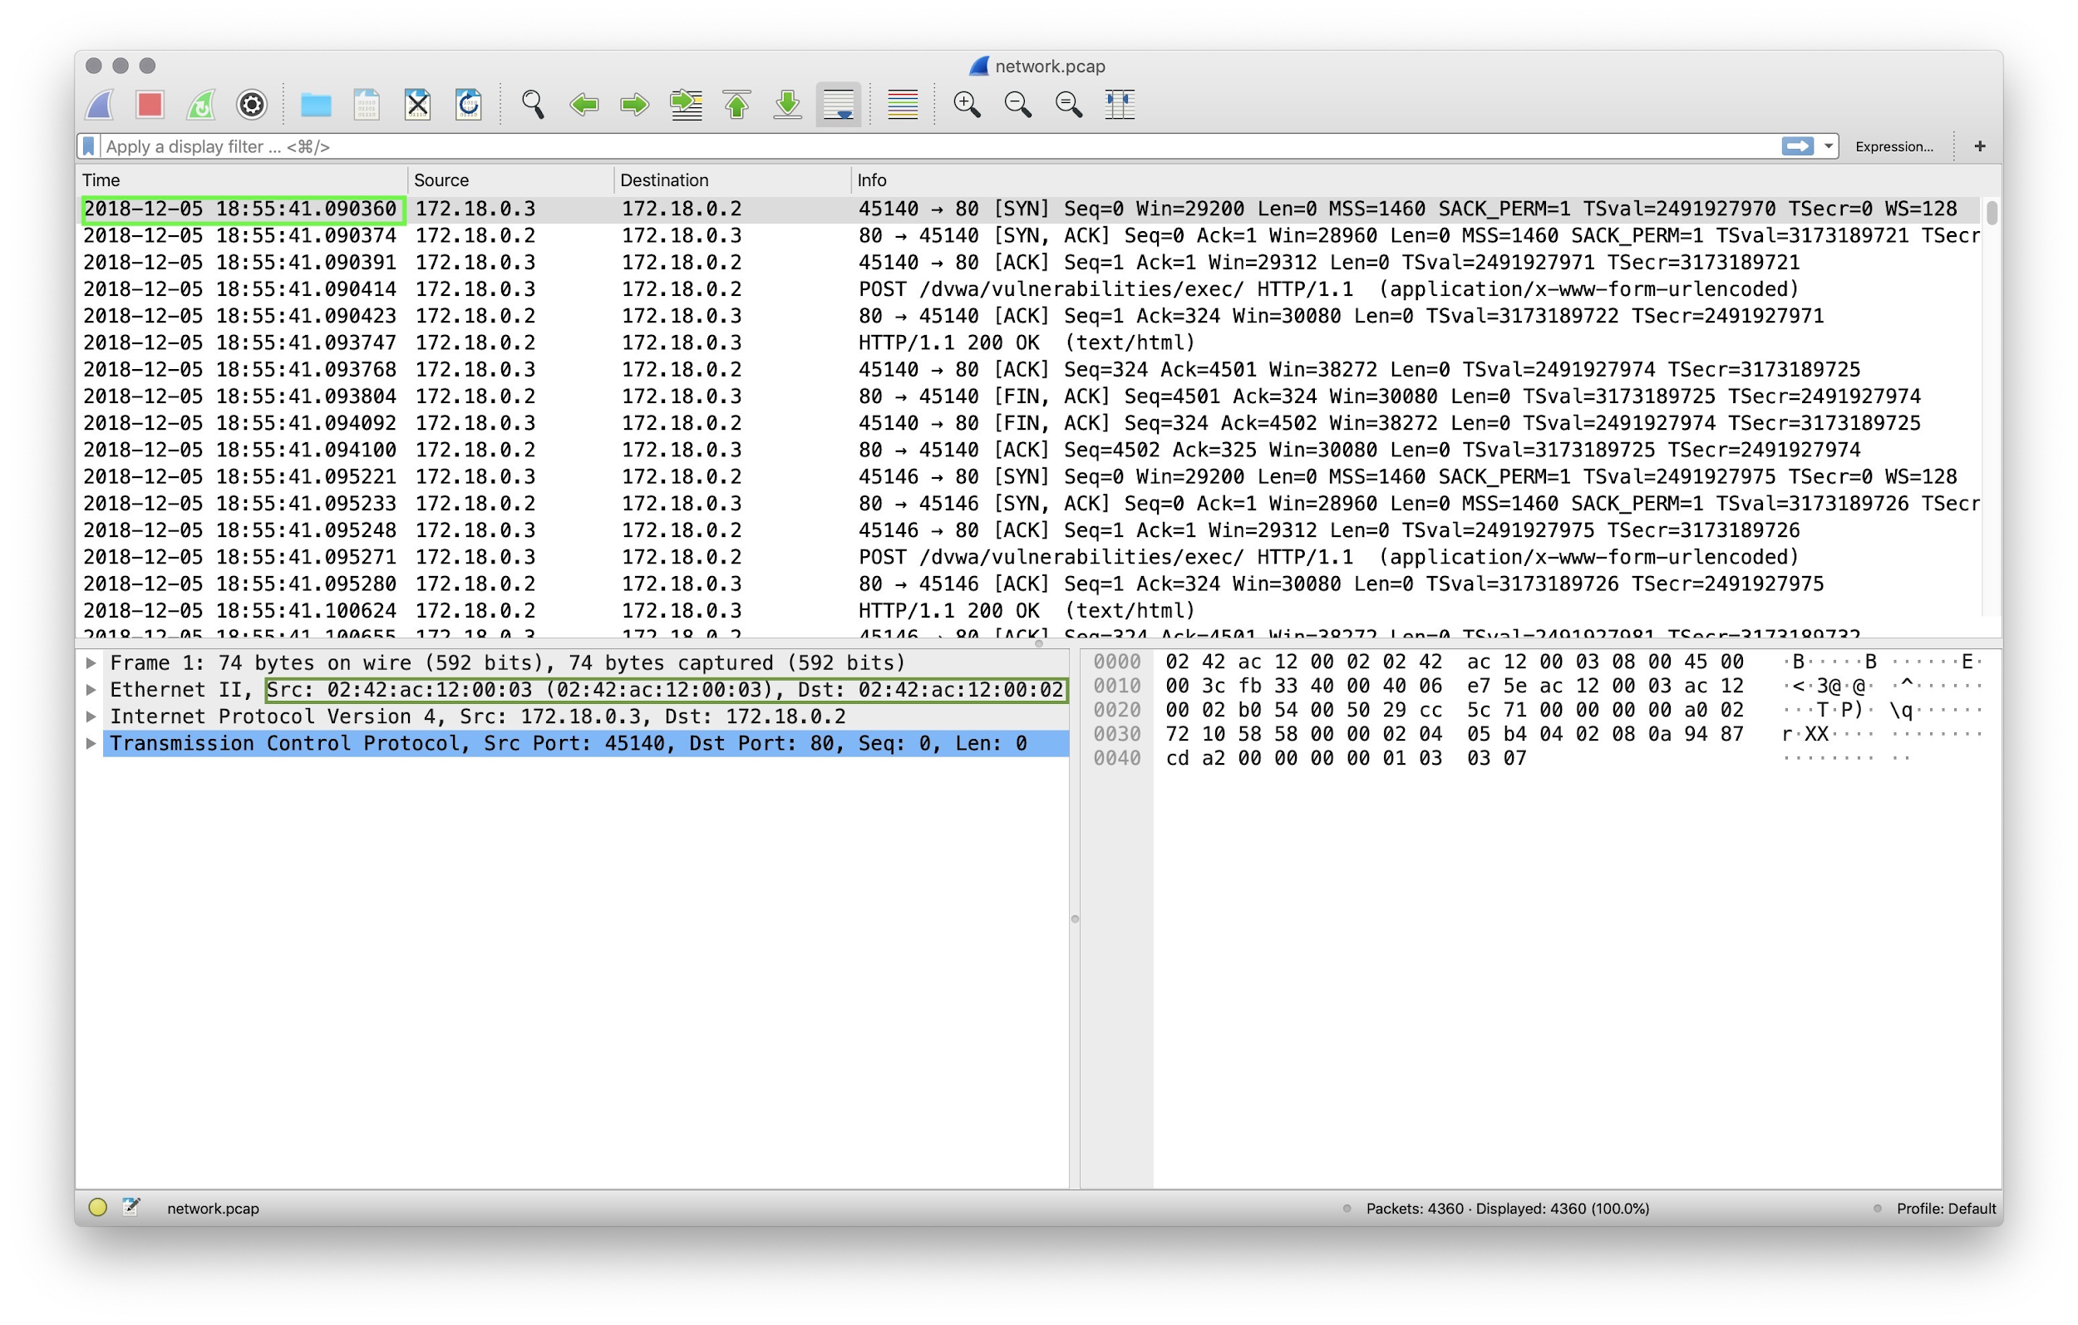
Alert 4 Review
What is the MAC Address of the computers involved?
02:42:ac:12:00:02
02:42:ac:12:00:03
Can you confirm the date and time this issue occurred?

Slide 96
Alert 4 Review
What is the MAC Address of the computers involved?
02:42:ac:12:00:02
02:42:ac:12:00:03
Can you confirm the date and time this issue occurred?
The attack started on 2018-12-05 at 18:55:41 UTC.

Slide 97
Alert 4 Review
What was the target of the attack?

Slide 98
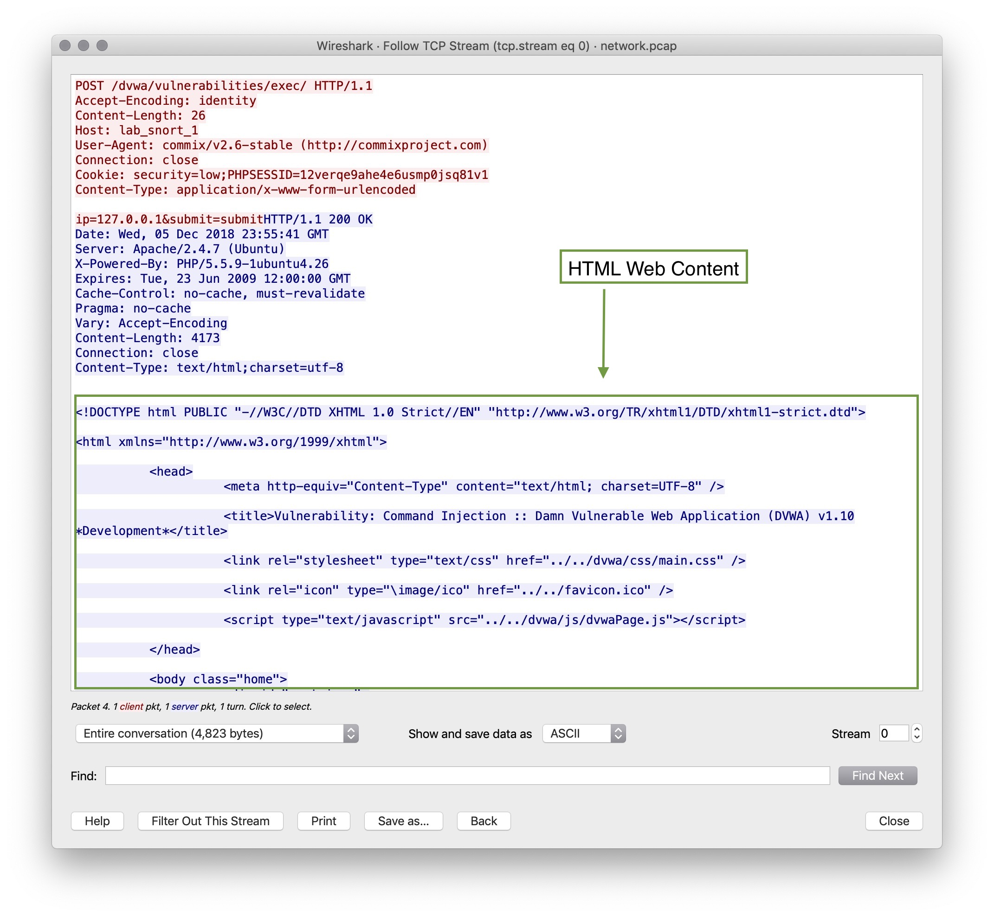
Alert 4 Review
What was the target of the attack?
The bash CGI Variable Injection Attempt alert suggests that this is a possible bash code injection attack.
The TCP Stream of the first packet listed shows the contents of the webpage returned.
This attack appears to be a code injection against an internal web server from an internal machine.

Slide 99
Alert 4 Review
How can we confirm the Snort alert is accurate?

Slide 100
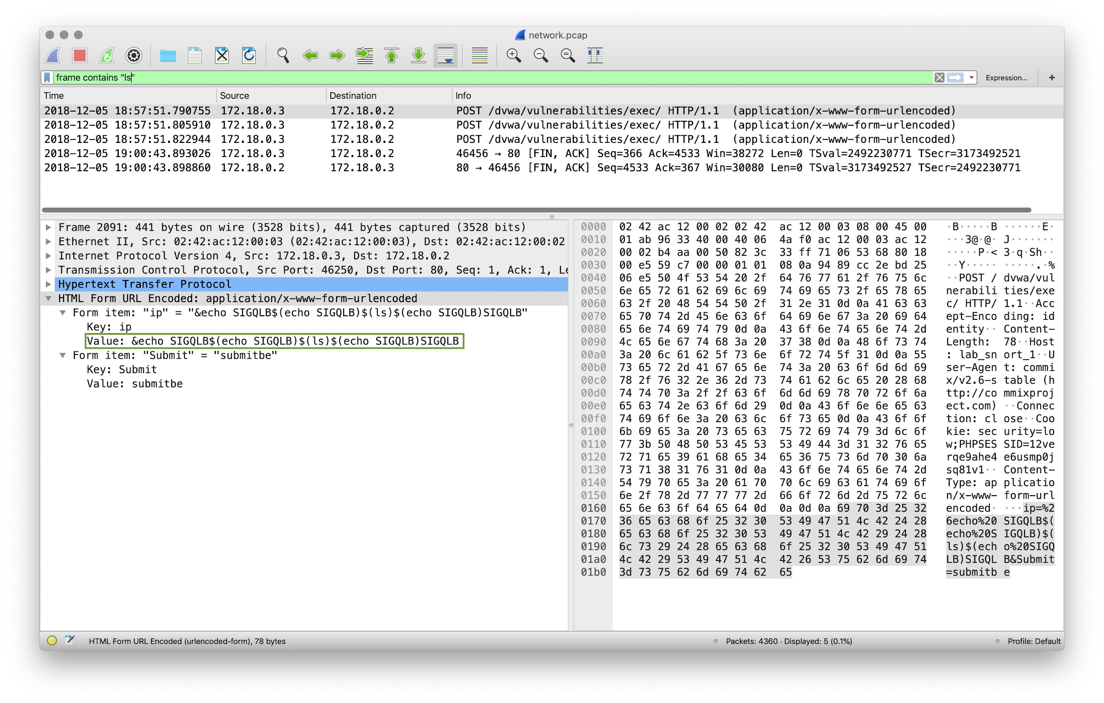
Alert 4 Review
How can we confirm the snort alert is accurate?
Filtering on “Frame contains [bash-command]” gives us many packets showing bash command execution.
Try frame contains “echo” and frame contains ls.
Under the HTML Form URL Encoded: section we can see values entered such as &echo SIGQLB$ (echo SIGQLOLB)$(ls)$(echo SIGQLB)SIGQLB
These are code injection attempts. The alert is accurate.

Slide 101
Alert 4 Review
Can you verify whether or not sensitive data has been obtained by the attacker?

Slide 102
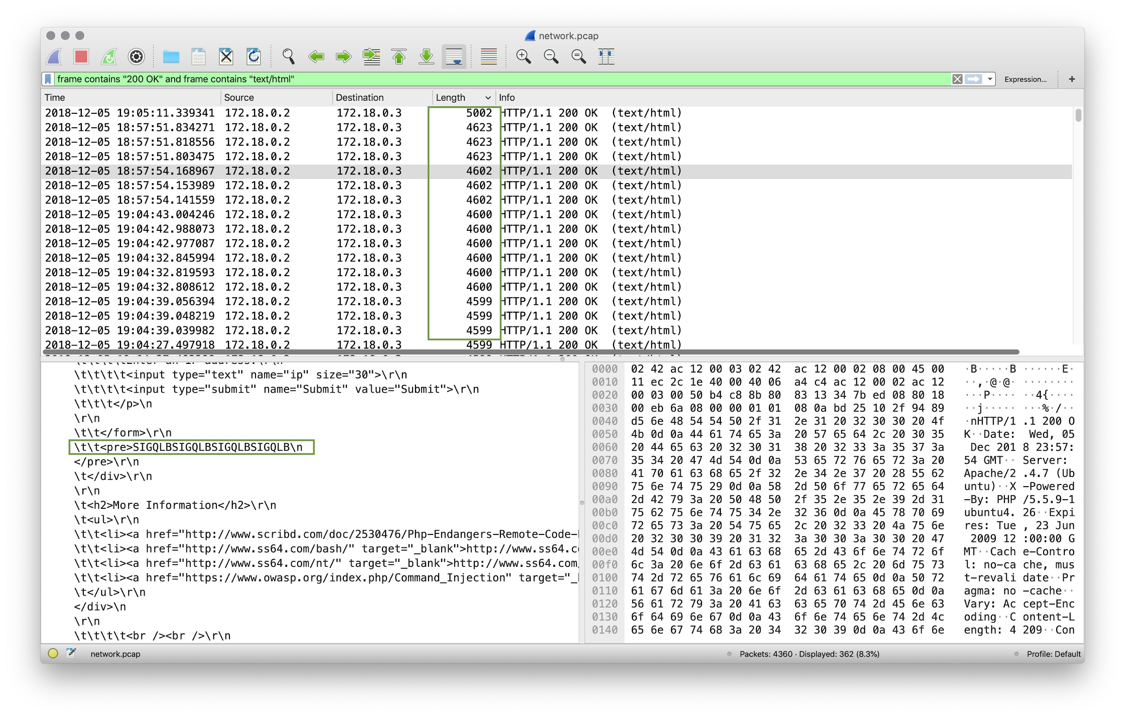
Alert 4 Review
Can you verify whether or not sensitive data has been obtained by the attacker?
Filtering for frame contains “200 OK” and frame contains “text/html”, we can see all the information returned by the server in it’s HTML content.
When we sort the packets by Length, we can see the largest packets returned which contain the most data.
It appears that the attacker only listed the contents of the webpage directory, but did not gain access to any sensitive data.

Slide 103
Alert 4 Review
Would you categorize this alert as a False Positive or a True Positive?
If this issue needs to be mitigated, what steps should be taken when the infected machine?
Would you categorize this issue as a Web, Email or Network attack?

Slide 104
Alert 4 Review
Would you categorize this alert as a False Positive or a True Positive?
This is a True Positive, because the code injection was successful.
If this issue needs to be mitigated, what steps should be taken when the infected machine?
Would you categorize this issue as a Web, Email or Network attack?

Slide 105
Alert 4 Review
Would you categorize this alert as a False Positive or a True Positive?
This is a True Positive, because the code injection was successful.
If this issue needs to be mitigated, what steps should be taken when the infected machine?
The internal machine that is attacking should be further investigated.
The web server application needs to be secured and data input better sanitized on this page.
Would you categorize this issue as a Web, Email or Network attack?

Slide 106
Alert 4 Review
Would you categorize this alert as a False Positive or a True Positive?
This is a True Positive, because the code injection was successful.
If this issue needs to be mitigated, what steps should be taken when the infected machine?
The internal machine that is attacking should be further investigated.
The web server application needs to be secured and data input better sanitized on this page.
Would you categorize this issue as a Web, Email or Network attack?
This is a code injection attack on a Web Application. The most appropriate classification would be Application Attack.

Slide 107
Part 5: Alert 5!
In this activity, you will respond to an alert and determine is it is a false positive or a true positive.
Instructions sent via Slack
30 minutes
30 minutes
⚠
Today's exercises involve live malware.
Use your Ubuntu VM to work in a contained environment.

Slide 108
Alert 5

Slide 109
Alert 5 Review
What activity is Snort Reporting On?
What is the time and date of the alert?

Slide 110
Alert 5 Review
What activity is Snort Reporting On?
2 Count:1 Event#3.81745 2019-04-15 16:42 UTC
3 ETPRO CURRENT_EVENTS MalDoc Requesting Ursnif Payload 2018-09-24
...
10 Count:2 Event#3.81747 2019-04-15 16:42 UTC
11 ET POLICY Binary Download Smaller than 1 MB Likely Hostile
...
18 Count:31 Event#3.81749 2019-04-15 16:42 UTC
19 ET POLICY PE EXE or DLL Windows file download HTTP
...
34 Count:5 Event#3.81877 2019-04-15 16:43 UTC
35 ETPRO TROJAN Ursnif Variant CnC Beacon 8 M1
What is the time and date of the alert?

Slide 111
Alert 5 Review
What activity is Snort Reporting On?
2 Count:1 Event#3.81745 2019-04-15 16:42 UTC
3 ETPRO CURRENT_EVENTS MalDoc Requesting Ursnif Payload 2018-09-24
...
10 Count:2 Event#3.81747 2019-04-15 16:42 UTC
11 ET POLICY Binary Download Smaller than 1 MB Likely Hostile
...
18 Count:31 Event#3.81749 2019-04-15 16:42 UTC
19 ET POLICY PE EXE or DLL Windows file download HTTP
...
34 Count:5 Event#3.81877 2019-04-15 16:43 UTC
35 ETPRO TROJAN Ursnif Variant CnC Beacon 8 M1
What is the time and date of the alert?
2019-04-15 16:42 UTC

Slide 112
Alert 5 Review
What is the external IP address and port that Snort is flagging?
What is the internal IP address and port that Snort is flagging?

Slide 113
Alert 5 Review
What is the external IP address and port that Snort is flagging?
91.240.87.19:80 #Malware is downloaded from this IP:Port
37.230.112.226:80 #Malware reaches out to this IP:Port for CNC commands
# Malware is downloaded
10 Count:2 Event#3.81747 2019-04-15 16:42 UTC
11 ET POLICY Binary Download Smaller than 1 MB Likely Hostile
12 91.240.87.19 -> 10.0.90.175
13 IPVer=4 hlen=5 tos=0 dlen=1500 ID=0 flags=0 offset=0 ttl=0 chksum=40298
14 Protocol: 6 sport=80 -> dport=49201
# Reaching out for CNC commands
34 Count:5 Event#3.81877 2019-04-15 16:43 UTC
35 ETPRO TROJAN Ursnif Variant CnC Beacon 8 M1
36 10.0.90.175 -> 37.230.112.226
37 IPVer=4 hlen=5 tos=0 dlen=480 ID=0 flags=0 offset=0 ttl=0 chksum=48545
38 Protocol: 6 sport=49203 -> dport=80
What is the internal IP address and port that Snort is flagging?

Slide 114
Alert 5 Review
What is the external IP address and port that Snort is flagging?
91.240.87.19:80 #Malware is downloaded from this IP:Port
37.230.112.226:80 #Malware reaches out to this IP:Port for CNC commands
# Malware is downloaded
10 Count:2 Event#3.81747 2019-04-15 16:42 UTC
11 ET POLICY Binary Download Smaller than 1 MB Likely Hostile
12 91.240.87.19 -> 10.0.90.175
13 IPVer=4 hlen=5 tos=0 dlen=1500 ID=0 flags=0 offset=0 ttl=0 chksum=40298
14 Protocol: 6 sport=80 -> dport=49201
# Reaching out for CNC commands
34 Count:5 Event#3.81877 2019-04-15 16:43 UTC
35 ETPRO TROJAN Ursnif Variant CnC Beacon 8 M1
36 10.0.90.175 -> 37.230.112.226
37 IPVer=4 hlen=5 tos=0 dlen=480 ID=0 flags=0 offset=0 ttl=0 chksum=48545
38 Protocol: 6 sport=49203 -> dport=80
What is the internal IP address and port that Snort is flagging?
10.0.90.175 over port 49201 and 49203

Slide 115
Alert 5 Review
Use the pcap file to answer the following questions:
What is the MAC Address of the internal computer involved?

Slide 116
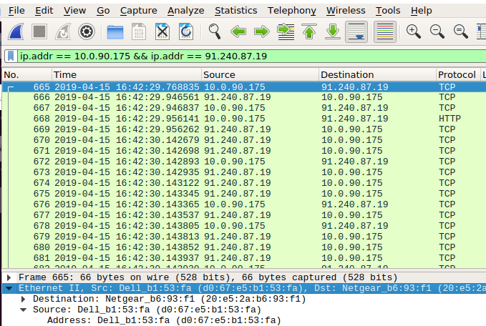
Alert 5 Review
Use the pcap file to answer the following questions:
What is the MAC Address of the internal computer involved?
Ethernet II, Src: Dell_b1:53:fa (d0:67:e5:b1:53:fa)

Slide 117
Alert 5 Review
Use the pcap file to answer the following questions:
What is the host name of the internal machine?

Slide 118
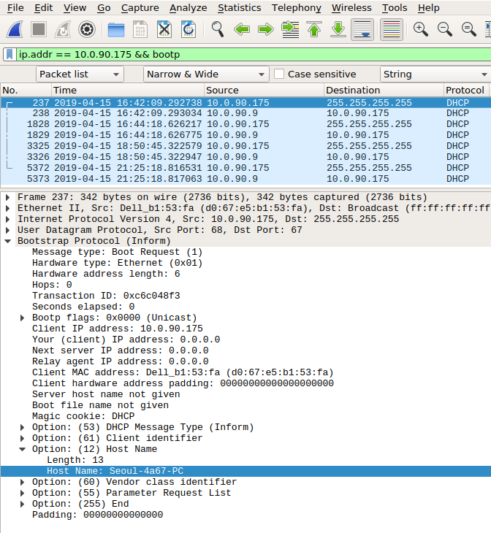
Alert 5 Review
Use the pcap file to answer the following questions:
What is the host name of the internal machine?
Seoul-4a67-PC

Slide 119
Alert 5 Review
Can you confirm the date and time this issue occurred? Does it match the snort alert?

Slide 120
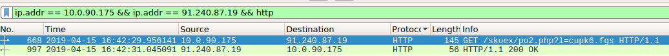
Alert 5 Review
Can you confirm the date and time this issue occurred? Does it match the snort alert?
2019-04-15 16:42 UTC # snort alert
...
2 Count:1 Event#3.81745 2019-04-15 16:42 UTC
3 ETPRO CURRENT_EVENTS MalDoc Requesting Ursnif Payload 2018-09-24
4 10.0.90.175 -> 91.240.87.19
5 IPVer=4 hlen=5 tos=0 dlen=131 ID=0 flags=0 offset=0 ttl=0 chksum=41667
6 Protocol: 6 sport=49201 -> dport=80
7
8 Seq=0 Ack=0 Off=5 Res=0 Flags=******** Win=0 urp=29384 chksum=0
Wireshark reports 2019-04-15 16:42:29.956141

Slide 121
Alert 5 Review
Can you confirm if the Snort alert was accurate and malware was downloaded?

Slide 122
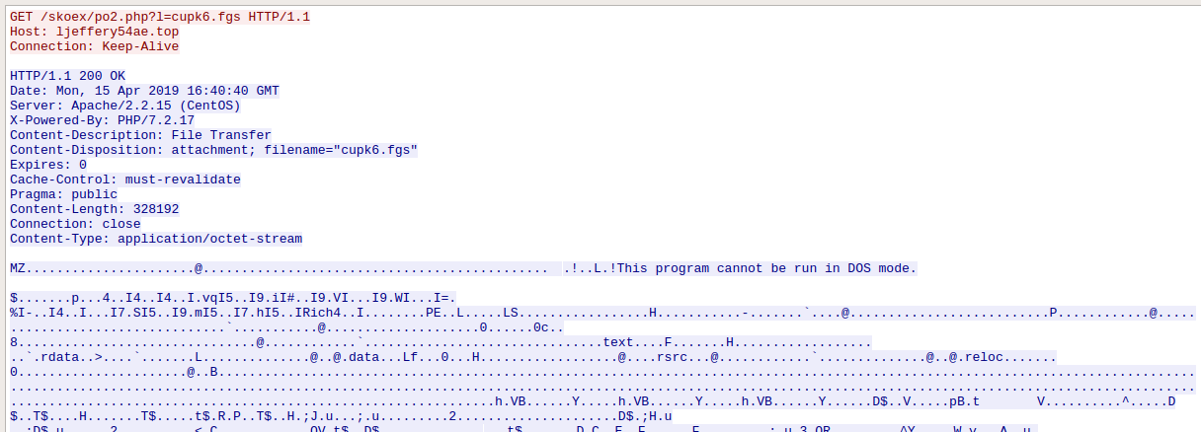
Alert 5 Review
Can you confirm if the Snort alert was accurate and malware was downloaded?
We can confirm that the Snort alert time was correct. We can follow the TCP stream and see that there was indeed a binary downloaded with the file name po2.php?1=cupk6.fgs:

Slide 123
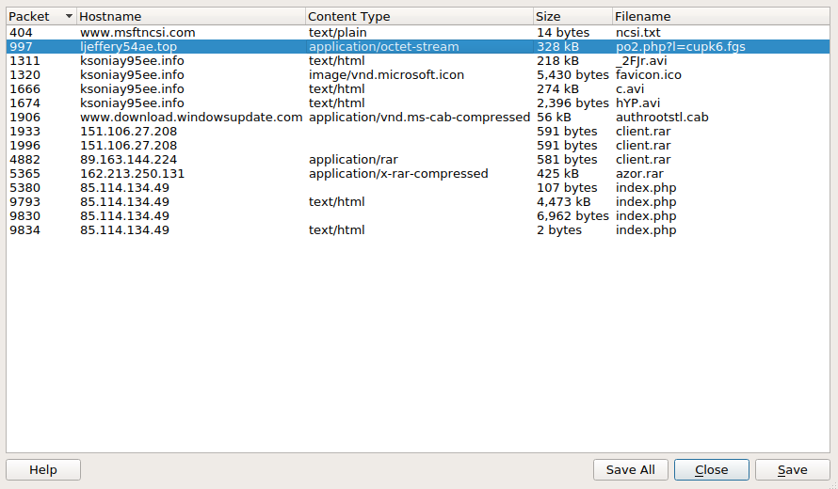
Alert 5 Review
Can you confirm if the Snort alert was accurate and malware was downloaded?
We can export this file from wireshark, hash it and run the hash through virustotal to verify that it is malware:

Slide 124
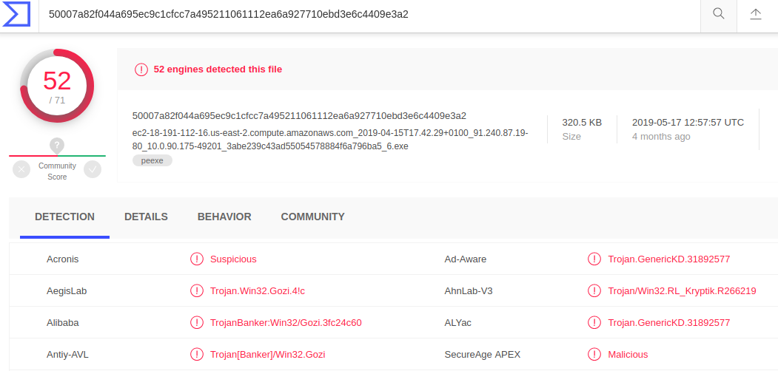
Alert 5 Review
Can you confirm if the Snort alert was accurate and malware was downloaded?
# hash the file with md5sum
$ md5sum po2.php?1=cupk6.fgs
3abe239c43ad55054578884f6a796ba5 po2.php%3fl=cupk6.fgs
Check with virustotal:

Slide 125
Alert 5 Review
Would you categorize this alert as a False Positive or a True Positive?
If this issue needs to be mitigated, what steps should be taken with the infected machine?
What steps should be taken in regards to network security?
Would you categorize this issue as a Web, Email or Network Attack?

Slide 126
Alert 5 Review
Would you categorize this alert as a False Positive or a True Positive?
This is a true positive because malware was downloaded.
If this issue needs to be mitigated, what steps should be taken with the infected machine?
What steps should be taken in regards to network security?
Would you categorize this issue as a Web, Email or Network Attack?

Slide 127
Alert 5 Review
Would you categorize this alert as a False Positive or a True Positive?
This is a true positive because malware was downloaded.
If this issue needs to be mitigated, what steps should be taken with the infected machine?
This machine should be restored from a backup point before the incident.
What steps should be taken in regards to network security?
Would you categorize this issue as a Web, Email or Network Attack?

Slide 128
Alert 5 Review
Would you categorize this alert as a False Positive or a True Positive?
This is a true positive because malware was downloaded.
If this issue needs to be mitigated, what steps should be taken with the infected machine?
This machine should be restored from a backup point before the incident.
What steps should be taken in regards to network security?
The IP address 91.240.87.19 and 37.230.112.226 should be blocked by a firewall.
Would you categorize this issue as a Web, Email or Network Attack?

Slide 129
Alert 5 Review
Would you categorize this alert as a False Positive or a True Positive?
This is a true positive because malware was downloaded.
If this issue needs to be mitigated, what steps should be taken with the infected machine?
This machine should be restored from a backup point before the incident.
What steps should be taken in regards to network security?
The IP address 91.240.87.19 and 37.230.112.226 should be blocked by a firewall.
Would you categorize this issue as a Web, Email or Network Attack?
This is a trojan horse web attack because the malicious file was disguised as normal traffic, sent from a website while the user was browsing the site.

Slide 130
For Homework:
You will create a post-incident report for each of the four incidents we worked on today.
Homework will be sent via Slack.
Any Questions?

